Slide 1
Inflection Points and Lightning Rods

Slide 2
“Though seemingly sudden, inflection points are not random nor unexpected. Every ‘overnight’ shift is actually the final stage of a process that has been subtly building over time.”
Rita McGrath, End of a Competitive Advantage

Slide 3
FINTECH…We were hit by lightning and didn’t have a lightning rod to LESSEN THE DAMAGE…
Ecosystem vs Industry disruption
Control the lightning strike…
Transformative time

Slide 4
BOLD PREDICTION #1
We are on the cusp of the MOST IMPACTFUL AND DISRUPTIVE change in the history of the financial services industry

Slide 5
A GREAT PHILOSOPHER ONCE SAID:
“All this happened once, and it will happen again”
PETER PAN

Slide 6
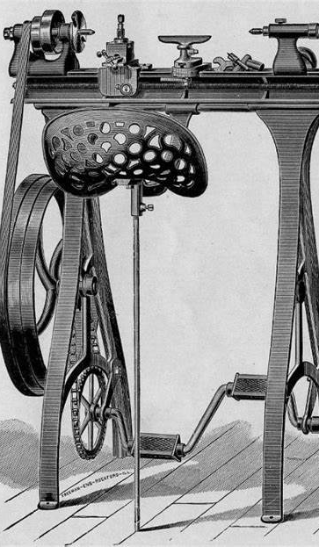
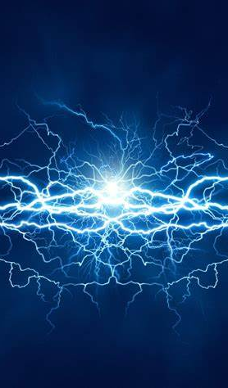

Slide 7
COMMON THEMES..
Law of Diminishing Returns
A Catalyst Emerges

Slide 8
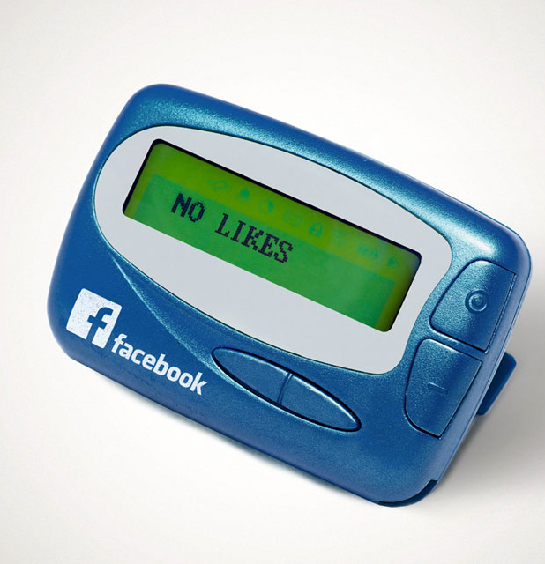
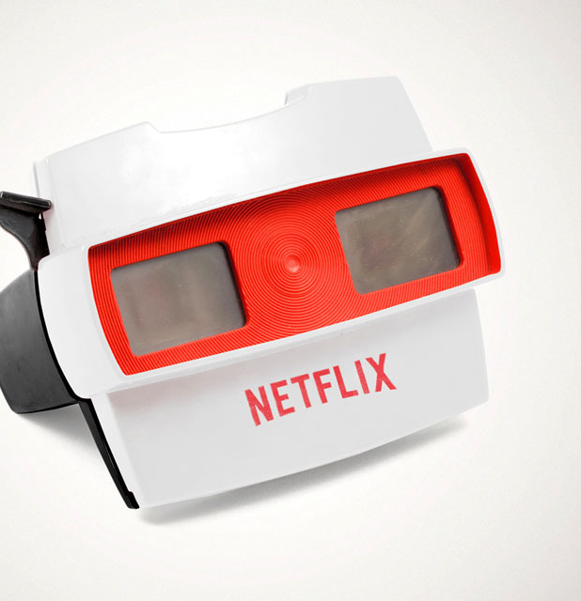
Where are we today?

Slide 9
BOLD PREDICTION #2 BLOCKCHAIN HAS ARRIVED AS THE CATALYST

Slide 10
BLOCKCHAIN…SO WHAT?
Distributed Ledger Technology
Digital Assets
Smart Contracts

Slide 11
THE VALUE PROP: PROGRAMABLE MONEY

Slide 12
BOLD PREDICTION # 3
BANKS WILL CREATE THE ONRAMP TO BLOCKCHIAN using tokenized deposits moving between fiat and digital forms for money AND The US will not adopt a retail CBDC where the Federal Reserve holds depository accounts

Slide 13
BOLD PREDICTION #4
BANKS WILL LEAD IN TAKING BLOCKCHAIN MAINSTREAM because of our expertise in creating and managing RISK FRAMEWORK

Slide 15
Inflection Points and Lightning Rods

