Slide 1
Hiring Event: Why Workers are Demanding On-Demand Payments
Notes:
Carrie:
Hello, everyone. Thank you for joining us today.
This is Carrie Staut with Netspend, and I’ll be your host for today’s Hiring Alert webinar where we’ll discuss “Why Workers are Demanding On-Demand Payments” and answer your biggest questions about how earned wage access works.
Before we get started, please note that all attendee lines have been muted, but there will be several opportunities to interact during today’s event. You may ask a question at any time using the questions box on the control panel. We will answer questions throughout the session and follow up on any we don’t get to after today’s webinar.
We also have a few questions for you – so keep your eye out for our polling tool – we’ll be sharing your collective responses as we get them.

Slide 2
Today’s Presenter
Carrie Y Staut Director of Business Development Business Partnerships Group - Netspend
Notes:
Carrie:
Now let’s meet today’s presenters:
With me is Andy Garner, Senior vice president of our business partnerships group, and Dave Hill VP of our commercial products team. Andy has been in the paytech space for many years. He and his team help enterprise organizations solve some of their most pressing wage and benefit challenges. Welcome, Andy.
Andy: Thank you, Carrie. Hello everyone I’m so glad to see so many people joining us today.
Dave Hill ...
Thanks for joining us today, Dave.
Dave: Hi Carrie, glad to be here as well, and welcome to everyone on the line today.

Slide 3
Our Agenda
1
Survey Background
How Employee Needs are Driving Demand & Three Trends
Employer Options: How to Deliver Solutions That Matter
Your Questions: How Earned Wage Access Works
Employer Benefits
2
3
4
5
Notes:
Carrie:
Let’s give everyone a quick preview of what we’ll be covering today:
Netspend regularly commissions research to keep our fingers on the pulse of employer and workforce needs, and today we’ll be sharing some of the most timely insights that reflect today’s challenging hiring market.
We’ll give you a bit of background on what the research covers,
And then dive into 3 big trends around employee needs
We’ll outline several of the best ways that employers can respond to these trends,
Along the way, we’ll answer some of the most frequently asked questions employers have about delivering earned wage access and other solutions.
And, while the benefits for your workforce are front and center today, you’ll also see how employers benefit from a more financial stable workforce.

Slide 4
The Data: Workforce Survey
Section 1
1000 Workers
500 Employers
Numerous Industries
Full-time
Part-time
Contract (Gig)
Payroll and benefit leaders
Enterprise to SMB
Retail
Restaurant
Healthcare
Manufacturing
Gig Workers
Others
Notes:
SPEAKER: Carrie
•Netspend surveyed more than 1,000 full-time, part-time, and contract workers as well as more than 500 employers across multiple industries.
•This research revealed the steps businesses have been taking to navigate evolving workforce dynamics, as well as additional tactics they can take to provide workers with the tools and resources they desperately need to reach financial security.

Slide 5
How Employees’ Needs are Driving Demand
Section 2
Notes:
To kick off our discussion, Andy is going to talk to us about how Employees’ needs are driving deman for Earned Wage Access benefits.
Andy!

Slide 6
Hourly workers feel financially insecure, as a result, employer costs are rising:
How Employees’ Needs are Driving Demand
57%
150 hours of productivity are lost each year by employees under financial distress³
33% of earnings are lost³ per employee every year due to financial stress, resulting in costly turnover⁴
of workers are financially insecure²
2 Netspend Survey: Employee Health and Wellness, Survey of 1,000 U.S. adults, December 2020, pg. 5
3 Visa, April 2020, “Merchants and consumers turn to tap to pay as part of new daily routines” https://usa.visa.com/visa-everywhere/blog/bdp/2020/04/30/merchants-and-consumers-1588276426783.html
3 SHRM, 2019, “To Have and To Hold” https://www.shrm.org/hr-today/news/all-things-work/pages/to-have-and-to-hold.aspx
4 Netspend Survey: Employee Health and Wellness, Survey of 1,000 U.S. adults, December 2020, pg. 38
Notes:
SPEAKER: Andy
•The COVID-19 pandemic significantly impacted the financial security of both hourly workers and their employers.
•Now, employers are scrambling to rebuild workforces amidst record U.S. job openings¹.
•As they consider new ways to stand out in this ultra-competitive hiring marketplace, employers have realized they need to restructure their wage and benefits offerings to be more responsive to workforce needs.

Slide 7
What Workers Want
Employers who support their financial health
Earned wage solutions that are vetted by their employers
Benefits that help mitigate financial insecurities
How Employees’ Needs are Driving Demand
1
2
3
Notes:
SPEAKER: Andy
Three key trends emerged from the research that can give employers a better understanding of what additions and changes they can make to hiring packages that will enable them to be more successful at attracting loyal, productive, and healthy hourly workers and reduce recruitment and attrition costs.
Read through each trend

Slide 8
Polling Question:
Today, do you offer tools or benefits that support financial health?
Notes:
Carrie – let’s hear from our audience – take a look at the question on your screen and let us know: Do you offer tools or benefits that support financial health? We’ll give you about 10 seconds.
Depending on responses:
Dave:
Low Yes: there’s still misalignment between what workers need and what employers are providing, but it is improving. We see that by the great attendance today and huge interest in this topic
High Yes: this is great to see- employers are more responsive than ever to workers needs. We also see that by the great attendance today and huge interest in this topic

Slide 9
Workers want employers to support their financial health with more than higher wages.
How Employees’ Needs are Driving Demand
44%
of employees have not been able to save money because of pandemic stresses⁵
50%
of the workforce say financial insecurity has disrupted their workday⁶
31%
of workers reported quitting a job due to financial instability⁷
17%
have lost a job because of financial distress⁸
5 Netspend Survey: Employee Health and Wellness, Survey of 1,000 U.S. adults, December 2020, pg. 6
6 Netspend Survey: Employee Health and Wellness, Survey of 1,000 U.S. adults, December 2020, pg. 5
7 Netspend, “The Restaurant Recovery: Three Pandemic Trends-Turned-Opportunities”, April 2021 Page 4 https://www2.e4.netspend.com/l/533722/2021-04-09/h4ygm8
8 Netspend Survey: Employee Health and Wellness, Survey of 1,000 U.S. adults, December 2020, pg. 38
Notes:
Andy
1.Wage rates have always been a significant factor for employers trying to attract hourly workers.
2.But how workers get paid is just as important, or even more so, when it comes to employment preferences and selection.
3.With financial stress negatively impacting employee engagement, productivity, and retention, workers are saying they want more employer support for their financial health and wellness.
4.Many employers are trying to compete by offering more aggressive compensation packages, but they are learning prospective hourly employees need more than the promise of higher hourly wages to feel secure and productive.

Slide 10
The Takeaway:
Employers who incorporate programs to help their workforce manage and stabilize financial security will stand out in the hiring crowd and be able to attract more loyal, productive, and financially stable workers.
How Employees’ Needs are Driving Demand
Section #
Notes:
Carrie
With all of the challenges in hiring and retention as workers, we can see why providing benefits such as an Earned Wage Access benefit to your employees is incredibly helpful.
Next, Dave is going to share more about Earned Wage Access

Slide 11
Workers Want Earned Wage Access
How Employees’ Needs are Driving Demand
77%
of employees want faster access to earned wages⁹
79%
of workers are interested in working for employers who provide on-demand access to earned wages¹⁰
37%
of hourly workers would consider changing employers for access to earned wages.¹¹
9 Netspend, “Power of the Pivot: Embracing Three Major Pandemic-Driven Trends”, April 2021 Page 4
https://www2.e4.netspend.com/l/533722/2021-04-09/h4ygm4?li_fat_id=1aac4863-dc55-4bf9-901d-e9241510e7f8
10 Netspend, “Power of the Pivot: Embracing Three Major Pandemic-Driven Trends”, April 2021 Page 4
https://www2.e4.netspend.com/l/533722/2021-04-09/h4ygm4?li_fat_id=1aac4863-dc55-4bf9-901d-e9241510e7f8
11 Netspend, “Power of the Pivot: Embracing Three Major Pandemic-Driven Trends”, April 2021 Page 4
https://www2.e4.netspend.com/l/533722/2021-04-09/h4ygm4?li_fat_id=1aac4863-dc55-4bf9-901d-e9241510e7f8
Notes:
Dave
1.If you’re among the many employers who are looking for new ways to stand out in an increasingly difficult employment market, and if you’re with us today, you’re familiar with the idea of paying your workforce a portion of their wages faster than the traditional payroll cycle of every two weeks.
2.Netspend research has confirmed this benefit is in high-demand among workers - especially hourly workers - many of whom see huge advantages to the flexibility of accessing wages sooner than biweekly.
3.Check out these data points on the topic

Slide 12
What is Earned Wage Access?
Data: Employer provides basic enrollment and wage data to the provider
Mobile App: An interface that allows employees to view funds available and transfer to their chosen account
How Employees’ Needs are Driving Demand
A technology platform that allows employees to access wages earned, but not yet received, through the traditional payroll cycle.
1
3
Funding: The provider funds the transfer, which is later reimbursed by the employee after payday
Deductions: EWA platform provides a list of all EWA transactions, which are deducted from the employee's paycheck
2
4
Notes:
Dave to speak to What EWA is.

Slide 13
They also want an Earned Wage Access provider vetted by their employer.
How Employees’ Needs are Driving Demand
+
+
+
+
Reputable and stable provider
Fast and simple onboarding
Great user experience
Multiple options to receive funds
Notes:
Dave
Workers have indicated they want an earned wage access solution that is provided by a trusted source, such as their employer or bank, as an option to avoid high interest loans,
They also want a simple sign-up process, interactive mobile app, and the ability to select transfer amounts and transaction limits.

Slide 14
Polling Question:
Are you having trouble with recruiting, retention or both?
Notes:
Carrie - We have another question we’d like to poll the audience about.
We are seeing feedback from our research about recruiting and retention, but we want to hear from you. We’ll take about 10-12 seconds for you to put in your answer.
Andy and Dave, how do you interpret these results?

Slide 15
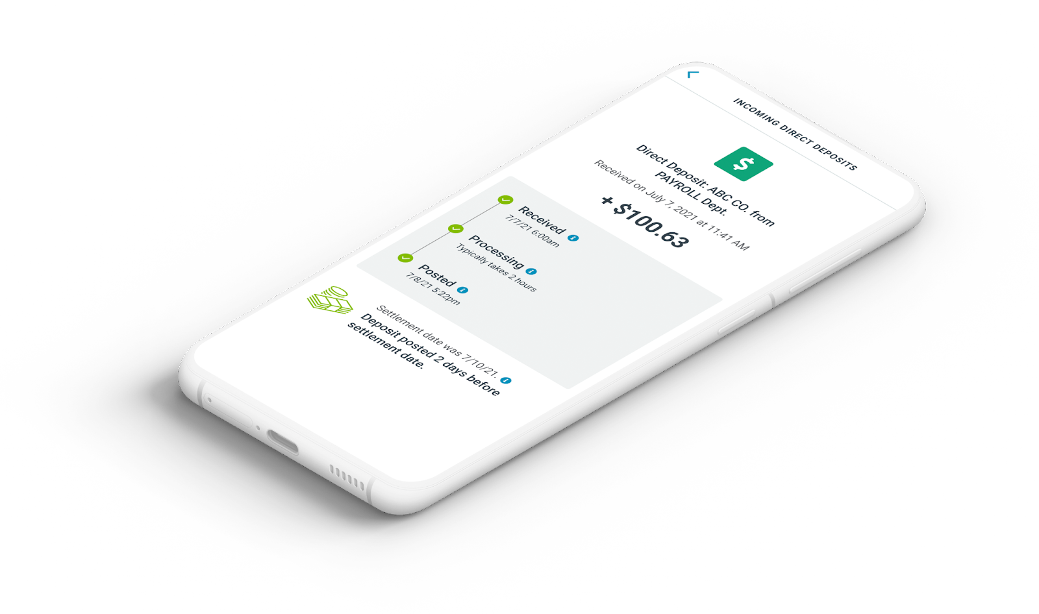
Employer options: How to deliver solutions that matter
Section 3
Notes:
Now, Andy is going to talk about some of the other financial wellness benefits you can provide.

Slide 16
Financial wellness benefits drive long-term results
Earned Wage Access
Savings Programs
Digital Payments Tools
Mobile Financial Tools
Employer options: How to deliver solutions that matter
Notes:
Speaker-Andy:
Earned Wage Access – as we’ve discussed, there are numerous benefits to your workforce, helping them to become more financially stable and reducing stress
Savings Programs: Access to savings further enables workers to build a stronger financial foundation.
36% would switch jobs to deposit wages in a savings account that earns interest without needing to have a bank account¹⁴
Digital Payments offer instant access to without the burden and expense of check cashing fees.
Mobile Financial Tools make managing money on the go faster and easier. This is key to minimize work and life disruptions and enable access to online and mobile payments.
¹⁴ Netspend, “Power of the Pivot: Embracing Three Major Pandemic-Driven Trends”, April 2021 Page 5 https://www2.e4.netspend.com/l/533722/2021-04-09/h4ygm4?li_fat_id=1aac4863-dc55-4bf9-901d-e9241510e7f8

Slide 17
Q&A
Notes:
Carrie:
•When we talk to people who are considering an earned wage program, they have a lot of question about how it works – what does it mean for their business and their workforce.
•Many of you also submitted questions when you registered for today’s session or in the question tool during the webinar
•We’re going to spend the rest of our time answering a few of the most common questions
•Don’t worry – if we don’t get to your question during this session, we’ll share an FAQ document after the call.
•Please keep those questions coming, we’ll be sure to get them answered.

Slide 18
Who funds Earned
Wage Access?
Notes:
Dave
Not a loan - opportunity to speak to the fundamentals

Slide 19
How fast do workers get their earned wages?
Notes:
Andy

Slide 20
What does Earned Wage Access cost workers?
Notes:
Andy

Slide 21
What changes will there be to my payroll process?
Notes:
Dave

Slide 22
Q&A
Notes:
Carrie:
•When we talk to people who are considering an earned wage program, they have a lot of question about how it works – what does it mean for their business and their workforce.
•Many of you also submitted questions when you registered for today’s session or in the question tool during the webinar
•We’re going to spend the rest of our time answering a few of the most common questions
•Please keep those questions coming.

Slide 23
Thank You.
For More Information Contact
Carrie Staut
cstaut@netspend.com
© 2021 Global Payments Inc. All rights reserved worldwide. Global Payments is the federally registered U.S. service mark of Global Payments Inc. Netspend is the federally registered U.S. service mark of Netspend Corporation. All other trademarks and service marks belong to their owners.
Notes:
Carrie
Thanks for joining
Remember if we didn’t get to your question today feel free to reach out to me. My contact information is on the screen.
Have a great afternoon everyone

