Slide 1
The Future of Payments
Nashville TN AFP Meeting
November 10, 2022
Dave Lott
Retail Payments Risk Forum

Slide 2
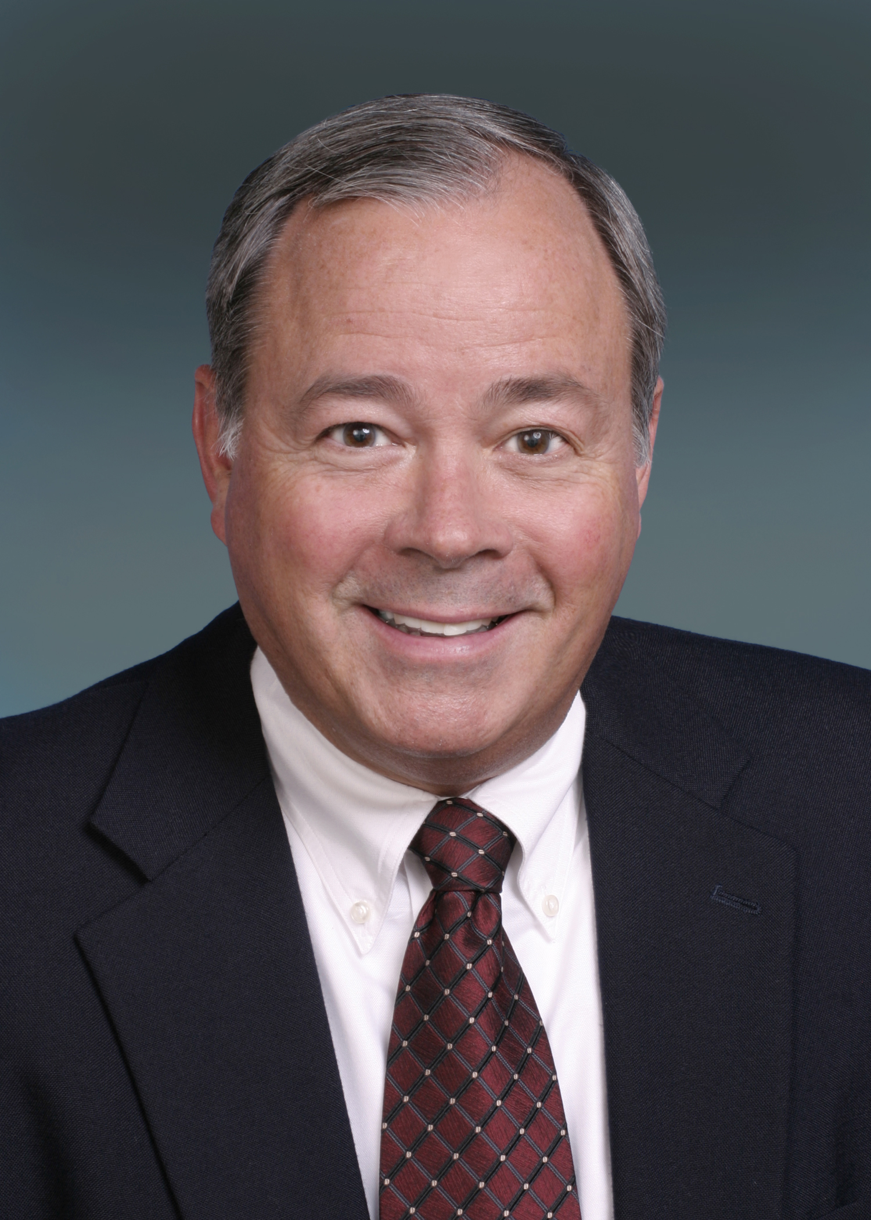
TODAY’S PRESENTER
●    
Dave Lott
Federal Reserve Bank of Atlanta
Retail Payments Risk Forum
Payments Risk Expert
mailto:david.lott@atl.frb.org
The views expressed in this presentation are those of the speaker and may not necessarily represent the views of the Federal Reserve Bank of Atlanta or the Board of Governors.

Slide 3
RETAIL PAYMENTS RISK FORUM
●    
We serve as a catalyst for collaboration in the consumer and commercial payments risk management arena.
We:
Conduct research and provide analysis
Convene and share with interested parties
Promote actions through educational channels to mitigate risk
Take On Payments weekly blog
Retail Payments Risk Forum webpage
2021 Survey/Diary of Consumer Payment Choice

Slide 4
TODAY’S CONVERSATION: COVID-19 PANDEMIC AND…
Current payments landscape
Changes during COVID timeline
What the future holds?

Slide 5
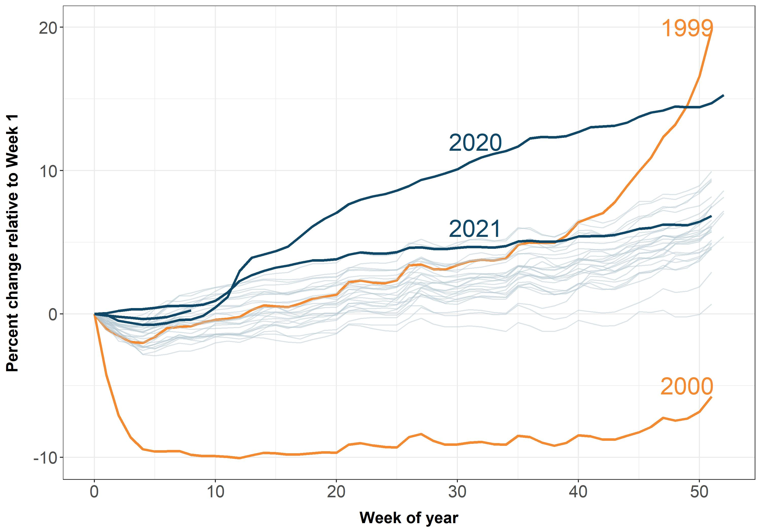
CURRENCY IN CIRCULATION SURGES IN 2020
Source: Federal Reserve Bank of St. Louis (FRED)

Slide 6
STORE-OF-VALUE HOLDINGS REMAIN HIGH
US consumers increased cash holdings at the time of the pandemic shutdowns
Stuck at home
Stimulus payments
Emergency preparedness
Overall holdings have continued to increase
Source: 2020, 2021 DSCPC
.

Slide 7
PAYMENT CARDS ARE DOMINATE PURCHASE METHOD
Percentage shares of purchases by payment instrument
. Source: 2021 Survey/Diary of Consumer Payment Choice

Slide 8
PAYMENT METHOD PREFERENCES: IN-PERSON vs. REMOTE
. Source: 2021 Survey/Diary of Consumer Payment Choice

Slide 9
CONSUMER TRENDS ACCELERATED
Technology adoption trended up for at least the past 5 years.
Changes from 2019 to 2020 were pronounced.
2020 Diary: 44% of bill pay via ACH methods (BANP, OBBP)
Source: Survey of Consumer Payment Choice

Slide 10
SENTIMENT ON CASH AVOIDANCE: “NO”
●    
April: Are you avoiding using cash because of the coronavirus?
August: For the in-person payments that you have made in the past 30 days, have you avoided using cash because of the coronavirus?
April 2020 Survey: 70% said “No”
August 2020 Survey: Three-fourths said “No”
Sources: USC Dornsife Understanding Coronavirus in America

Slide 11
MOBILE PAYMENTS INCREASED DRAMATICALLY
Share of Consumers Making Mobile Payments¹
¹Made at least one mobile payment in prior twelve months
Source: 2021 Diary of Consumer Payment Choice

Slide 12
SHARE OF REMOTE FOOD PAYMENTS EBB IN 2021
●    
Percentage of food purchases made remotely
Sources: 2021 Survey/Diary of Consumer Payment Choice

Slide 13
REMOTE PURCHASES CLIMBED
Remote purchases up to 16%
Card share of purchases grew
Switch to online drives cash decline
Cash use in person declined
Source: Survey of Consumer Payment Choice

Slide 14
P2P BACKGROUND
Prior to 2020, Peer-to-Peer (Person-to-Person) payments were dominated by paper-based transfers
Currency, check, money order
Cash: 75% of P2P in 2016, down to 50% by number in 2021
Electronic P2P grew strong in 2021
Source: 2021 Diary of Consumer Payment Choice.
14

Slide 15
OUR COMPANY
WHAT NEXT?
“
Distinguishing the signal from the noise requires … the serenity to accept the things we cannot predict, the courage to predict the things we can, and the wisdom to know the difference.
Nate Silver

Slide 16
The views expressed in this presentation are those of the speaker and may not necessarily represent the views of the Federal Reserve Bank of Atlanta or the Board of Governors.
PAYMENT LANDSCAPE PREDICTIONS
Cash and check usage will continue to be cannibalized
Authentication of the customer will be more and more important
EMV 3DS and stepped-up authentication
Death of the password? Never!
Biometrics technology will continue to improve and cost less
Facial / Fingerprint will continue to dominate
Behavioral biometrics for ecommerce will become more affordable and prevalent
Buy Now, Pay Later
Consumer adoption continues to grow
CFPB has raised a number of issue
Faster payments
FedNow launching in mid-2023 to compete with Clearinghouse’s RTP
Significant pricing difference with ACH
16

Slide 17
MAJOR PAYMENTS ISSUES
Open Banking
Will happen to some degree but customer adoption uncertain
Serious data privacy and control issues
Central Bank Digital Currency
Fed’s direction is unclear at this point
Customer liability on Push Payments
UK’s Contingent Reimbursable Model (CRM) being promoted for the U.S. market
Does CFPB have the ability to mandate without Congressional authority?
17

Slide 18
Connect with us @Atlanta Fed

