Slide 1
HR – Challenges, Solutions, and The Great Resignation
Presented by: Brett Johnson

Slide 2

The challenge
The world of HR and the business of People
Businesses need to find, hire, and keep the best employees.
They also need to reduce the workload of HR processes like payroll and reporting.
And they need to make meeting compliance and other legal requirements much much easier.
Notes:
48% of HR leaders say they expect recruiting to be more difficult in 2022. (isolved’s 2022 Transforming Employee Experience Report)
22% of HR leaders say competitors with larger budgets is the top threat facing talent acquisition. (isolved’s 2022 Transforming Employee Experience Report)
25% of HR leaders say their most valuable recruiting tool is employee referrals. 49% are offering cash referral bonuses as incentives. (isolved’s 2022 Transforming Employee Experience Report)
HR leaders say employee experience is their company’s biggest opportunity to improve HR this year

Slide 3
The evolving nature of HR
v
Employees are hard to attract and even harder to keep. 56% of HR leaders say retaining talent was more difficult in 2021.
(isolved’s 2022 Transforming Employee Experience Report)
HR processes are time consuming and need constant attention to avoid errors. By 2024, 60% of employee-related HCM technology transactions will be accomplished via preconfigured, employee-initiated workflows.
(Gartner, Nov. 2021: Market Guide for Integrated HR Service Management Solutions)
v
The government keeps changing the rules, compliance mandates are complex, and many businesses miss out on tax credits. The second most likely task for HR leaders to outsource this year is HR compliance and efficiency analysis.
(isolved’s 2022 Transforming Employee Experience Report)
2nd
Highest
Outsourced
HR Compliance and efficiency analysis
Notes:
55% of employees say they haven’t referred candidates to open positions at their current employer. The top reason is because they are unaware of open positions, followed by lacking leadership and bad culture. (isolved’s 2022 HR Trends report)
45% of employees applied for a new job in 2021, and 47% of those employees rated the applicant experience as poor. The top reason why they rated the experience as poor is because they didn’t hear back from the company. (isolved’s 2022 HR Trends report)
52% of employees were tempted to leave their job in 2021. The top reasons were that they didn’t like their supervisor’s management style and because there wasn’t room for growth. (isolved’s 2022 HR Trends report)

Slide 4
If you’re finding it difficult, you’re not alone…

Slide 5
The challenge
It’s getting more challenging
45% of employees plan to look for a new job this year.
More than half of employees rate their organization’s employee experience as average or poor.
75% of employees say they suffered burnout over the last year.
(isolved’s 2022 HR Trends Report)
48% of chief human resources officers (CHROs) say their current HR technology solutions hinder, rather than improve, employee experience
(Gartner, 2021: Top Strategic Technology Trends for HR Leaders)
Notes:
21% of employees say they feel like their boss is a detriment to their mental isolved’s Voice of the Workforce Report)
health. (

Slide 6
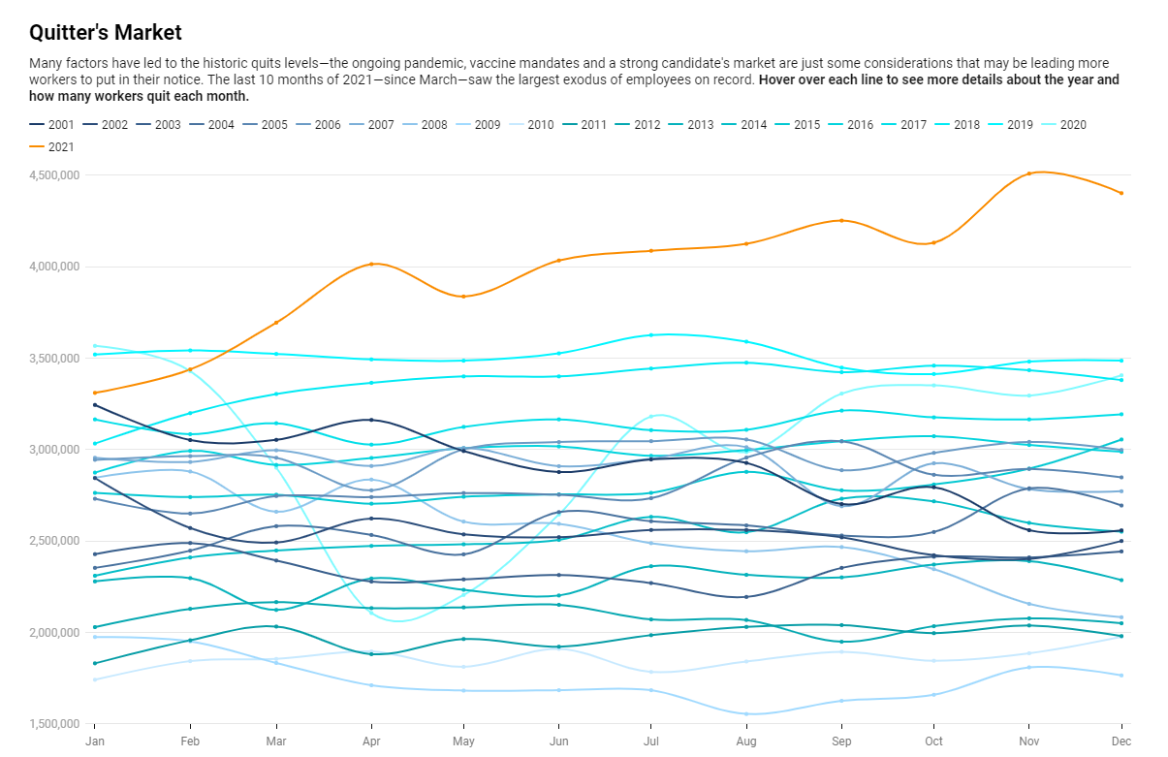
Market Trends: Unprecedented Departures

Slide 7
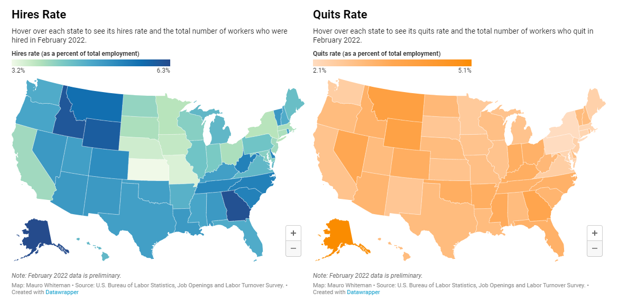

Slide 8
“The Great Resignation means that the workforce has shrunk and it's unlikely to return to pre-pandemic numbers. Companies must deliver outstanding employee experiences
if they want to attract and retain desirable talent.”
– Dr. Edie Goldberg for SHRM Study on Performance Enablement, March 2022
Market Trends

Slide 9
The How

Slide 10

My ask for you to consider
How well are you able to recruit employees when you need them?
How easy is it for you to train and retain your best?
How do you reduce the work of operational things like payroll and HR reporting?
How sure are you, based on your data, that you’re doing what’s needed to keep and develop the best workforce possible?

Slide 11

The right way to do this
Successful HR teams are becoming:
More agile – because things are changing fast
More data-driven – because your business needs decisions taken on data, not gut feel
More focused on employee-experienced – because losing your best employees is something no business can afford

Slide 12
Agility is Critical
The Agile HR Team
The pandemic proved that companies that had already invested in modern work tech and employee engagement best practices were more prepared to pivot overnight to the demands of the new workplace and their employees.
Most significantly, that level of rapid change is unlikely to go away any time soon. HR organizations must focus on becoming highly agile in their processes – fast to react to changes in business strategy, market conditions and employee expectations.

Slide 13
Data is the key to Better Decisions, Faster
The Data-Driven HR Team
HR Teams will better access to data are able to make better decisions more confidently (to become a strategic partner to the business). Employees also need to be access the information they need, where they need them, wherever they already work.
HR departments must now help business leaders manage from a position of insight based on data, not gut-feel, relying simply on what has worked in the past. Therefore, they must employ systems that provide a fully rounded view of the employees and their work, that bring together performance metrics and behavioral drivers, and that can easily present meaningful, actionable insight to leaders making complex but critical decisions regarding the workforce.

Slide 14
Putting Employee Experience at the Center
It’s all about the Experience
People-centered HR processes that engage and retain the very best talent to ensure business continuity and competitive advantage. Employee expectations for how they accomplish daily HR and payroll tasks are changing and HR teams must also help employees feel more connected and engaged with their employer, the business goals, and their broader community.
The battle to find, recruit, enable, and retain the best employees will be the defining test of businesses in the next five years. Those businesses that can offer the most consistent, employee-centered experience will be able to attract and retain the best workforce. Those that do not will lose key staff and become less and less competitive as a result.

Slide 15

The Future of Work
The path through the challenges today is:
To empower HR teams to be agile, data-driven, and employee experience centered.
To elevate the role of HR from operational to strategic through technology and services that free them to focus on transforming their business
To redefine the relationship between employee and employer based on the best experience, that makes it easier to recruit, develop, and retain the best employees

Slide 16

The Employee Experience-Centered
From initial onboarding onwards the experience is designed with employees in mind
Collaboration tools and goal setting
Self-service to empower employees
Training for career development
Analytics that let you model what matters to your employees

Slide 17
Thank You!

