Slide 1


LEASE ACCOUNTING STANDARD
Beyond the Basics
Presenter
Buck Freeman, CPA
Shareholder,
Audit & Advisory Services, LBMC
May 12, 2022
Notes:
Hello – I am very excited to be here with you today talking about leases. I’m sure we’ve all heard about the recent changes, but hopefully today we can dig a little deeper than the general high level impact.
My name is Buck Freeman. I am a shareholder in the audit and advisory practice at LBMC in the Nashville office. I’ve spent the last 3 years consulting on this new standard.
We started assisting publicly traded companies with the initial transition at 1.1.19, but now we are starting to assist more private companies. In addition, we are helping public companies with day 2 accounting.
Our projects range from full project management with boots on the ground implementing lease accounting software to more esoteric topics such as complex lease transactions, internal controls, to general consulting around how to get started, or specific subtopics.

Slide 2

Overview of Changes
Computations and Journal Entries
Transition Journal Entries
Discount Rates
Terms
De Minimis Thresholds
Portfolio Approach
Variable Payments
Non-lease Components
Embedded Leases
Practical Expedients
Lender Considerations

Slide 3


OVERVIEW OF CHANGES
Presentation
Weighted-average remaining lease term
Weighted-average interest rate
Rent expense reconciliation
Scope
All Companies
All Leases with Terms > 12 months
Balance Sheet Presentation | 840 (legacy guidance) | 842 (new guidance)
Capital | Included | Included
Operating | Excluded (footnote only) | Included
Right-of-Use Asset
Lease Liability
Adoption Dates
1.1.2019 for public companies
1.1.2020 1.1.2022 for non-public companies
Brightline 75% and 90% tests are going away – however, most practitioners are maintaining this approach
Income Statement Presentation | 840 (legacy guidance) | 842 (new guidance)
Capital | Amortization and Rent Expense | Amortization and Rent Expense
Operating | Rent Expense | Rent Expense
Enhanced Disclosures
Classification | ASC 840 (Legacy Guidance) | ASC 842 (New Guidance)
Step 1 | Transfer of Ownership | Transfer of Ownership
Step 2 | Bargain Purchase Option | Purchase Option is Reasonably Certain to be Exercised
Step 3 | Lease Term Exceeds 75% of Useful Life | Lease Term is for Major Part of Remaining Economic Life
Step 4 | Present Value of Lease Payments Exceeds 90% of the FMV of Asset | Present Value of the Lease Payments Exceeds Substantially All of the FMV of Asset
Step 5 | None | Underlying Asset is so Specialized that has no Alternative Use
Cash Flow Statement Presentation | 840 (legacy guidance) | 842 (new guidance)
Capital | Int = Operating Prin = Financing | Int = Operating Prin = Financing
Operating | Operating | Operating
Notes:
Mention classification on the balance sheet – now finance vs capital
Straight line rent… no changes to EBITDA
Mention moving capital leases and lease commitments into one footnote
Rules based vs principles based

Slide 4
COMPUTATIONS & JOURNAL ENTRIES
Present Value of Minimum (1) Lease Payments Due Over Term (2)
Lease Liability
Variable lease payments are excluded from the minimum lease payments utilized in the initial valuation and recognized as expense when incurred.
The present value of the minimum lease payments will be determined using the incremental borrowing rate.
Lease Liability
Upfront Payments
Initial Direct Cost
Incentives
Right of Use Asset
Notes:
This is the day 2 ongoing accounting. WE WILL DISCUSS TRANSITION ACCOUNTING SHORTLY
Initial direct cost that are performance based… BROKERS
Incentives – such as an up-front refund or advance of funds
PREPAID RENT

Slide 5
COMPUTATIONS & JOURNAL ENTRIES
60,602 * 7% / 12
Rent expense is always 1,200; however, interest and amortization amounts are different at each reporting period
1,200 - 354
Straight line rent expense
Notes:
5 YEAR LEASE TERM
$1,200 A MONTH
7% INTEREST RATE
USING THE EXCEL PV FORMULA
I want to highlight that all you really need for lease measurement are 3 items…
A lot of people ask me if all these entries are really necessary. Can’t we just capitalize our lease payments without discounting? That is an option to the extent that you won’t have a material difference on your balance sheet presentation. But as the discount rate, term and payments grow; the difference can be significant.

Slide 6
TRANSITION JOURNAL ENTRIES
Public Companies
Transition Date
2017
2018
2019
2020
2021
Nobody Cares!!!
Included for Transition
Assumes the Prospective Transition Election
Facts and circumstances of all leasing arrangements as of this date
Notes:
The prospective transition election
FASB relief
Walk through an example

Slide 7
TRANSITION JOURNAL ENTRIES
Non-Public Companies
Transition Date
2020
2021
2022
2023
2024
Nobody Cares!!!
Included for Transition
Assumes the Prospective Transition Election
Facts and circumstances of all leasing arrangements as of this date
Notes:
JANUARY 1, 2022… WHO KNOWS THOUGH?!? THEY COULD KEEP EXTENDING!!!
Walk through an example… a lease that commenced in 1995…

Slide 8
TRANSITION JOURNAL ENTRIES
Assumes the Prospective Transition Election
Notes:
This is a company that is adopting on January 1, 2021
I get a lot of questions about should I use the discount rate at lease commencement… lease commencement for 842 purposes is the transition date
Assumes no prepayments, incentives, etc.
Note there is no equity entry with this entry – complex transactions
NOTE THE PRACTICAL EXPEDIENTS THAT WE WILL DISCUSS LATER

Slide 9
DISCOUNT RATES
ASC 842-20-30-2:3
Initial Measurement – “The discount rate for the lease initially used to determine the present value of the lease payments for a lessee is calculated on the basis of information available at the commencement date.
A lessee should use the rate implicit in the lease whenever that rate is readily determinable. If the rate implicit in the lease is not readily determinable, a lessee uses its incremental borrowing rate. A lessee that is not a public business entity is permitted to use a risk-free discount rate for the lease, determined using a period comparable with that of the lease term, as an accounting policy election for all leases.”
Rate implicit in the lease
Incremental borrowing rate
Risk-free rate (private co.)
Initial measurement date for leases in transition is the
Transition Date (i.e. January 1, 20XX)
Notes:
I could talk for an hour on discount rates, which I have. But what I want you to understand today is the impact of discount rates and your options.
The guidance gives us three options… Overall, the rate implicit in the lease is incredibly challenging to determine, especially if you have a large leasing portfolio,
Implicit rates require the assessment of fair value as well as facts about the lessors situation that wouldn’t be available to the lessee
IBRs are used almost exclusively in my experience… we will cover this later
RF is an accounting policy election for private companies
Initial measurement
Classification
Disclosure

Slide 10

DISCOUNT RATES
Portfolio Approach
FASB BC121 2016-02
BC121. The Board observed that the cost relief offered by applying the leases guidance at a portfolio level need not be limited to simply grouping contracts together. The cost relief also could be particularly high for certain aspects of the leases guidance for which entities need to make judgments and estimates, such as determining the discount rate or determining and reassessing the lease term.
For example, rather than establishing a specific discount rate for a single leased asset, an entity might conclude that it can establish a single discount rate applied to all leases in a portfolio because using that discount rate would not result in a materially different answer than using a discount rate determined for each individual lease. The implementation guidance in Subtopic 842-20 includes an example of one way a lessee might apply a portfolio approach in determining the discount rate for its leases.
 | Q1 – 2020 | Q2 - 2020
Lease term 2-5 | 5.25% | 5.15%
Lease term 6-10 | 5.75% | 5.65%
Lease term 11-15 | 6.00% | 5.90%
Lease term 16-20 | 6.35% | 6.45%
Lease term 21+ | 6.67% | 7.10%
This Photo by Unknown Author is licensed under CC BY-SA
Notes:
Without the portfolio approach…
The FASB gave us some relief with the portfolio approach
Here is an example that could be utilized

Slide 11
DISCOUNT RATES
Discount Rate
Term
Payment Stream
Impact Illustration of Discount Rates:
1%
15%
Notes:
Recall there are 3 things that drive the capitalization of the lease, or the initial measurement
DISCOUNT RATE BEING ONE OF THE MORE INFLUENTIAL ON THE CALCULATIONS

Slide 12
IMPACT OF DISCOUNT RATES
Lease Accounting
1%
15%
EBITDA
Debt Service
Debt-Service Coverage Ratio
1%
15%
Notes:
Carrying our example over from the previous slide…
Many companies have financial covenants and one of the most common is a debt service coverage ratio
Ebitda as a proportion of the debt service…

Slide 13
DiscouNT RATES
Wall Street Journal “Airlines Get a Break in New Accounting for Leases”
The reported liability for a lease represents all the future payments, discounted to give a current value. The bigger the rate used to determine the discount, the lower the liability. The rules allow a company in some cases to base the discount on the interest rate it would pay on a secured loan—with a perverse effect. As companies with poor credit have to pay high interest rates, they enjoy a bigger discount on their leasing obligations than stronger companies do.
One beneficiary is J.C. Penney Co. , which reported second-quarter operating-lease liabilities of $1.2 billion. That is based on an 11% discount rate, which is more than double the 4% average for S&P 500 companies, Calcbench data show. If Penney had used a 5% rate, its reported lease liability would increase some $400 million, to about $1.6 billion, according to financial technology firm New Constructs.
“It’s a loophole,” said David Trainer, chief executive of New Constructs. “It creates the potential for a pretty significant understatement of liabilities by struggling companies, such as J.C. Penney.”
Link
Notes:
Because of JC Penny’s discount rate being so high, their balance sheet impact was $400M less than expected had they used a 5% rate, which was the average for their peer group
Also, in this same article they described certain airlines getting their debt rating downgraded because the lease accounting impact was much greater than what their models were predicting
Analysts used to use a common multiplier by industry, in some cases that multiplier was incorrect

Slide 14
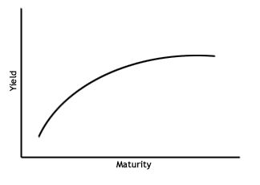
DiscouNT RATES
Incremental Borrowing Rate: Build a Synthetic Yield Curve
Steps
Choose a baseline curve
Identify company-specific observable debt
Compute a spread
Lay the spread along the entire baseline curve
For gaps in the terms, utilize linear interpolation or extrapolation to fill in the gaps
Notes:
HALF WAY POINT… SHOULD BE 8:30
If you decide to go the IBR route, you can build your own IBR curve. This is where I’ve been providing value to my clients is by building these models with an accompanying white paper.
There are 5 general steps to building a synthetic yield curve

Slide 15
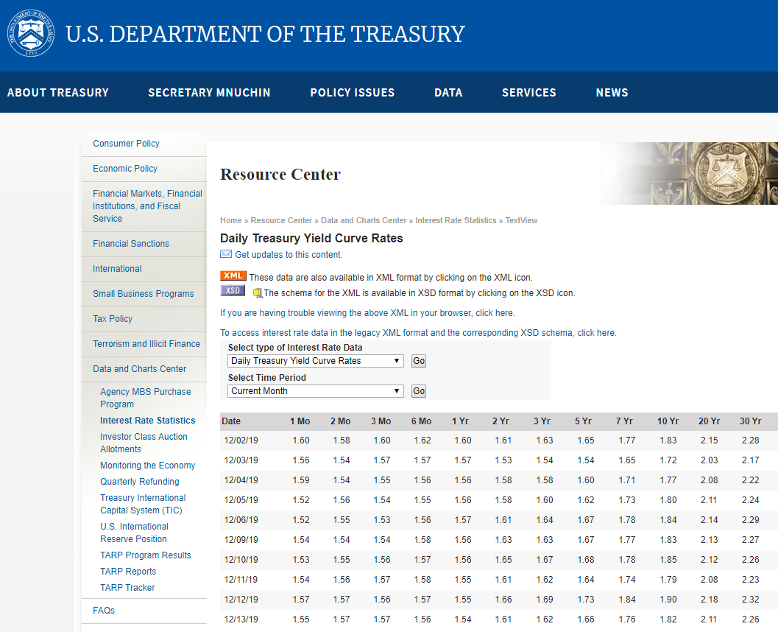
Build a synthetic yield curve
1: Choose a baseline curve
Risk-free rate
  https://www.treasury.gov/resource-center/data-chart-center/interest-rates/pages/textview.aspx?data=yield
High-quality market corporate bond yield curve
  https://home.treasury.gov/data/treasury-coupon-issues-and-corporate-bond-yield-curve/corporate-bond-yield-curve
Sector/credit-quality specific corporate yield curves
  Bloomberg
  Moody’s
  Fitch’s
  S&P
Notes:
You need a jumping off point…
If your credit quality is poor or you are in a niche sector, you might need to utilize a corporate yield curve from a rating agency

Slide 16

Build a synthetic yield curve
2. Identify company-specific observable debt
Primary Considerations:
Collateral
  What’s appropriate? “General assets of the company” is preferred
  Where the collateral liquidity approximates the leased asset
  Accounts receivable and cash deposits are considered to overcollateralize the borrowing and are inappropriate
  Loan-to-value ratio is a good starting point for determining collateral quality
  Credit enhancements tend to overcollateralize borrowing: letter of credit, personal guarantees, reserve accounts, etc.
Consider obtaining current pricing on the debt. If the debt is publicly-traded then it will make sense to utilize the current pricing in the market.
Notes:
Observable debt…
It’s all about the collateral package on the debt…

Slide 17
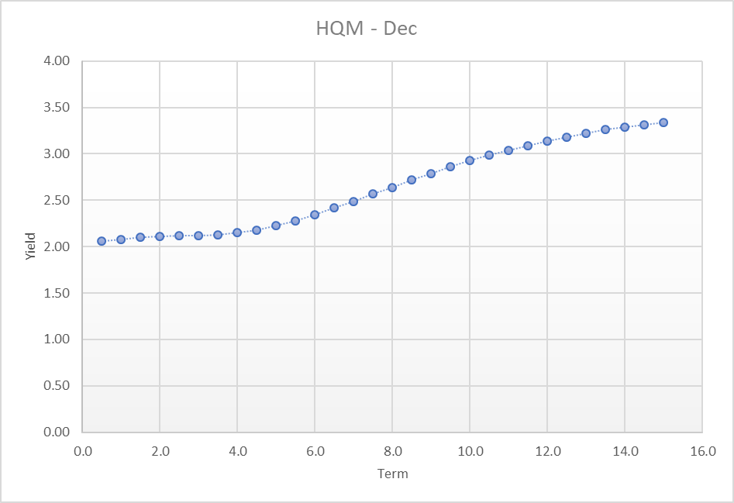
Build a synthetic yield curve
3. Compute a spread
Primary Considerations:
Spread is based on the remaining term of the observable debt, not the original maturity.
For example, if you have a 10-year secured borrowing and the remaining term when you build the model is 6 years, then you compute your spread off the 6-year yield.
Observable debt
Spread at 6 year
Notes:
This spread is the key to building your curve

Slide 18
Build a synthetic yield curve
4. Lay the spread along the entire baseline curve
Primary Considerations:
Spread is fixed for all terms
Notes:
Note the spread is fixed for all terms

Slide 19

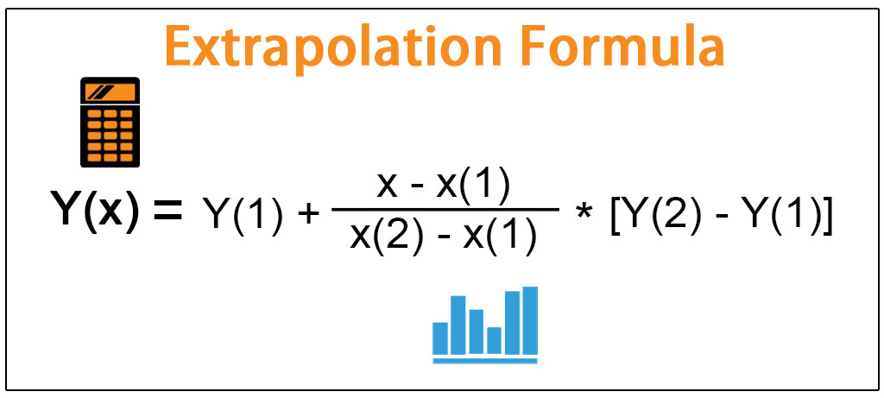
Build a synthetic yield curve
5. For gaps in the terms, utilize linear interpolation or extrapolation to fill in the gaps
Excel formulas can be used to do these computations
Even better… Excel VBA can do the calculations for you
Notes:
This is some complicated math, but you could easily plot the known rates from your model and draw a line to connect them. Then you will have your model.
To get fancy, you can do the math in excel or even develop a macro that does this work for you.

Slide 20

TERMS
The noncancellable period for which a lessee has the right to use an underlying asset, together with all of the following:
Rules based
Principles based
Periods covered by an option to extend the lease if the lessee is reasonably certain to exercise that option
Periods covered by an option to terminate the lease if the lessee is reasonably certain not to exercise that option
Periods covered by an option to extend (or not to terminate) the lease in which exercise of the option is controlled by the lessor.
Purchase options
Subleases
Terminations
Integrality of asset
Costs of returning asset
Leasehold improvements
Customizations
What is your intention with the lease?
What are your economic incentives?
But what about month-to-month leases?
Notes:
Consider a corporate headquarters lease with a base term of 5 years and two 5 year renewal options….
Start up vs. mature company

Slide 21

DE MINIMIS THRESHOLDS
Low value assets
IASB (international standards) bright line of $5,000 (max!)
Consider aligning with PP&E capitalization policy
Distinguish between capitalization threshold and what’s material for disclosure purposes
Notes:
8:40
Consider class of assets

Slide 22
PORTFOLIO APPROACH
Large number of similar leases (i.e. copiers, cell phones)
Use of judgment in determining size and composition of portfolio
Can be used for discount rates and determination of lease terms
Example:
Under this model: copier invoices are recorded to expense as incurred.
Notes:
The case against software
Here is an example that could be deployed to some lower dollar value equipment leases
I would recommend ensuring the common denominator in your portfolio is the underlying class of asset

Slide 23

Variable payments
General Rule: Don’t make assumptions when capitalizing
Use prevailing rate/payment at measurement date
Rent subject to changes in CPI
  Use Day 1 Rent Amount and don’t assume increases
  Payment increases are expensed as incurred
Rent subject to changes in CPI but will at least increase 1%
  The 1% is a mechanism that ensures increase
  The 1% is in-substance a fixed increase and is utilized in capitalization
  Payment increases beyond 1% are expensed as incurred
Notes:
Don’t make assumptions or predictions

Slide 24
Variable payments
CPI Example
Notes:
8:45

Slide 25

Non-lease components
Examples
Minimum consumable purchase requirements
Includes service of equipment
Common area maintenance included in fixed lease payment
Practical expedient to combine non-lease components with lease components as a single component
Why? Ease of capitalizing
Must be elected by class of underlying asset
Intention is to use this expedient with non-lease components that are insignificant
Notes:
Every lease has non-lease components… they’re typically very immaterial. Without this practical expedient GAAP requires us to bifurcate the lease and non-lease components.
However, due to the time and complexity associated with this exercise, the board provided this expedient. The intent of this expedient is to be used when the non-lease component is insignificant in proportion to the lease component.

Slide 26
Non-lease components
Service Forward Agreements
Don’t elect practical expedient: bifurcate lease component for measurement
Lease Component
Non-lease Component
Significant lease component agreements
Elect practical expedient: combine components for measurement
Lease Component
Non-lease Component
Consider
Classification!

Slide 27

Embedded leases
Examples:
Service agreements
Advertising agreements
Transportation agreements
IT agreements
Data storage agreements
Supply contracts
Lab equipment
ER equipment
Other medical equipment
“Embedded Lease” is not a GAAP term
Any Agreement that ISN’T Labeled “Lease Agreement” is in Scope
Review Considerations
Identify Areas of Concern: Advertising, IT, Supplies, Postage, Other
Collect Agreements for Consideration
  Is there a minimum purchase requirement (if no, no lease)?
  If there is a purchase minimum, put the agreement through the lease identification process under ASC 840… these should have already been identified…
  Quantify the Impact: PV of minimum lease payments (can be a difficult process)
  Determine if the CLASS OF UNDERLYING ASSET is material
Measurement requires the separation of the lease component from the non-lease components
Notes:
8:50

Slide 28

Practical expedients & policy elections
Package of practical expedients, must be elected together
  Whether a contract contains a lease
  Lease classification
  Initial direct costs
Use of hindsight to determine lease term
Combine lease and non-lease components
Prospective transition option
Short-term leases
Portfolio approach
Complex transactions…
Notes:
8:55

Slide 29
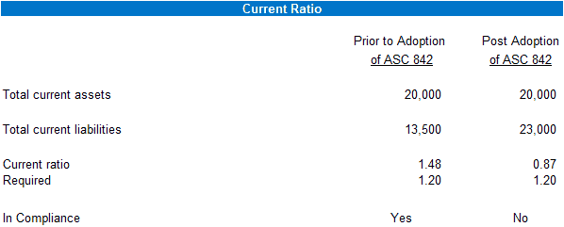
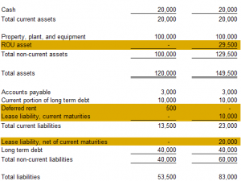
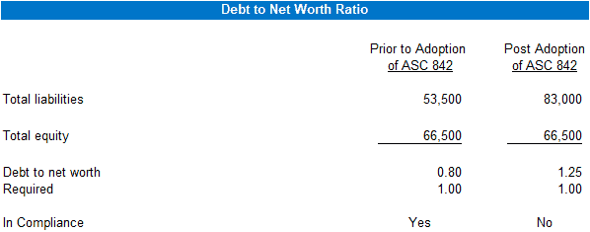
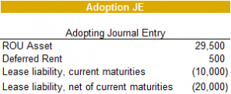
Lender considerations
Before 842
After
842
Notes:
8:55

Slide 30
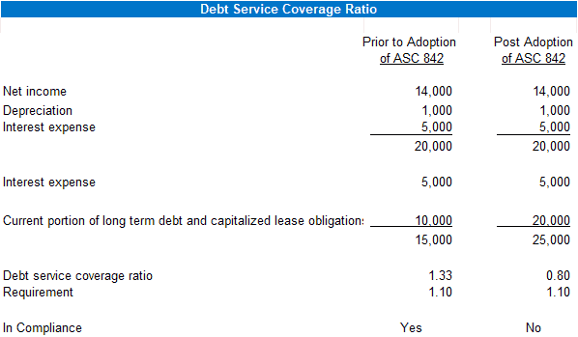
Lender considerations
Before 842
After
842
Notes:
8:55

Slide 31
Lender considerations
Before 842
After
842
Questions to ask:
To clients: have you modeled the impact of 842 on your financial covenants?
To clients: have you discussed the impacts of 842 with your investors/board?
Is GAAP frozen when the agreements are executed?
Do we need to amend our loan agreements?
Notes:
8:55

Slide 32

Buck Freeman
Shareholder, Audit & Advisory Services, LBMC
Buck.freeman@lbmc.com
615.309.2247
www.LBMC.com

