Slide 1
What is Going On With The Economy?
Presented To
Nashville Association For Financial Professionals
by
John Cross
Chief Investment Officer
Franklin Synergy Bank
October 12th 2017

Slide 2
Presenting to the CFO: Why Executive Presence Matters
9/13/2017 Renee Garin, CTP, FP&A sees FP&A as senior leadership’s eyes into the business. It’s the function’s job then, to gather all the information it can from the individual business lines and summarize that at an executive level. “You need to bring that information up to the board and the senior leadership team in a way that is meaningful to them, without bogging them down in all the details and whatnot,” she said. “I think that the way you gain credibility with them—even though you’re not quite on their level—is by being prepared. Know your materials, and know the analysis that led to the results that you’re about to present to them, because they’re going to ask you questions. So be prepared to give good answers.”
Notes:
I ‘m bringing a little bit of levity to the presentation by listing numerous tittles after my name, but I think it leads into the need for understanding today’s presentation … as financial professionals, try as we may to be specialized in a specific role… more often than not we have to be “pretty darn good” at several things rather than being really great at one thing”
The real trick though, comes in our ability to present to CFOs, CEOs and BODs their financial posture at the simplistic yet meaningful level.
In the Banking Industry our friends the Regulators want to make sure that “everything is being shared with the BODs. We’ll if I tried to explain the net present value of cash flows in determining Asset Liability Risk I might just get some blank stares, Instead you discuss the demise of the S&L industry and bring it into focus with IR Risk.
So today as we talk about the economy, hopefully you’ll come away with some decent tidbits that you can share on calls. I ‘ve yet to meet a CFO in 33 years of calling on them that didn’t have an opinion on what interest rates are going to do and why!

Slide 3
Agenda For Today Gather Information to Give Good Answers
World Economy
National Economy
Fed’s Outlook
Market’s Outlook
Local Economy
Throw In Some Fun Factoids
What Does All This Mean To Me?
Notes:
When we talk about “The economy” you have to start at the top which is the worlds economy and work your way down.

Slide 4
Global Economy
Notes:
We are a world economy. We trades on information across the globe that is only seconds old…not minutes or hours or days, but seconds old.

Slide 5
Gross Domestic Product
Notes:
https://knoema.com/atlas/ranks/GDP?baseRegion=CN
When we talk about “The World Economy” We need to realize we are talking not about the “G7 ” or “G8” we are talking about the “BIG 2” In 2016 US & China stood at a $30 Trillion dollar combined GDP….Would You like to Guess what the next 18 GDP’s combined add up to? You got it $30 Trillion Dollars!! When We Talk about Asia (China ,Japan, Korea, Indonesia,) $19.8 Trillion . When we talk about Europe (Germany, UK, Canada, France and Italy) We are talking about $12 Trillion.
As you here people on Bloomberg News or BBC or someone with a “British accent” (no offense to anyone here including myself) talk about how important the what’s going on …keep all this first and foremost in forming your perspective.

Slide 6
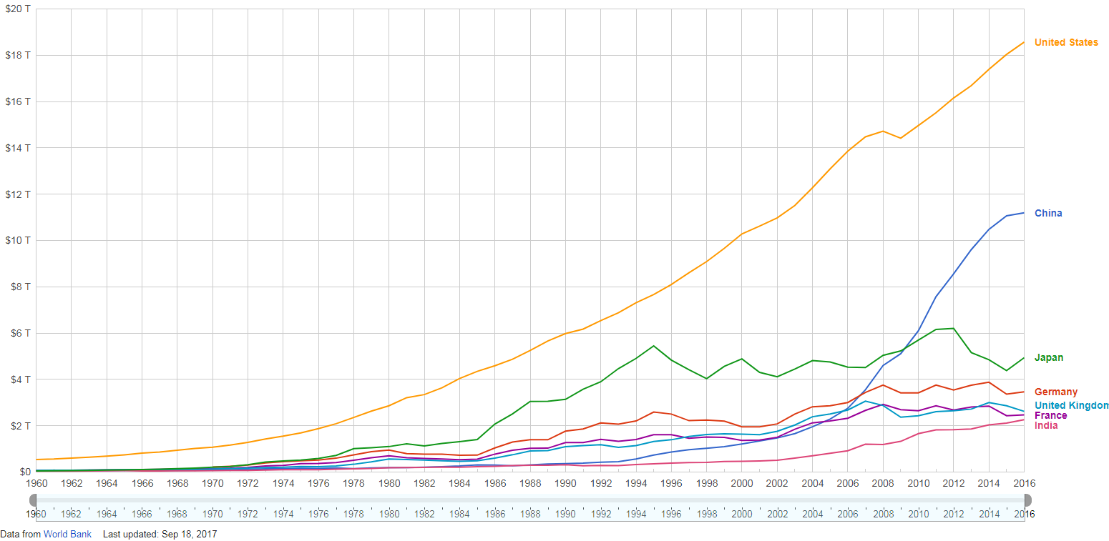
Top 7 World Economy’s GDP

Slide 7
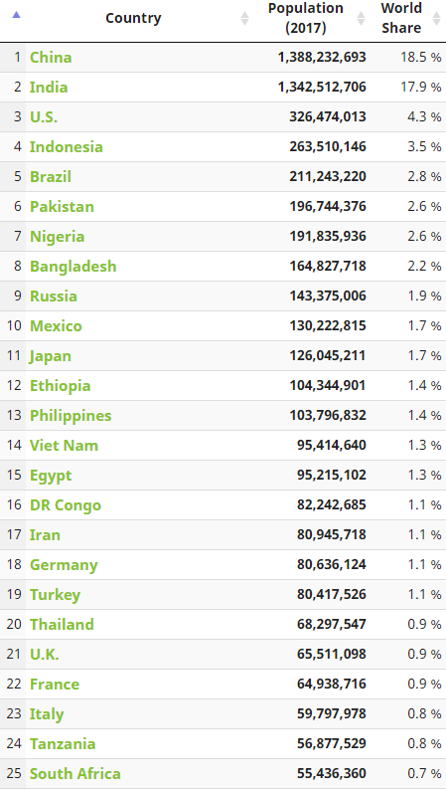
195 Countries in the World
Top 2 Countries make up 36% of the World’s population
Top 10 Countries make up 58% of the World’s population
Take the US out of the numbers and 54% of the world’s population has a weighted average GDP per capita…
$4,959 a year or $400 per month

Slide 8
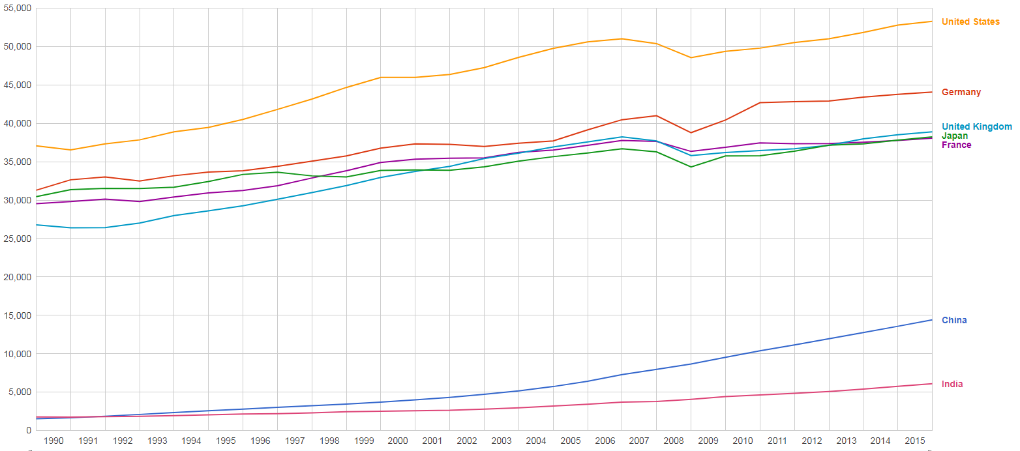
Top 7 World Economy’s GDP Per Capita

Slide 9
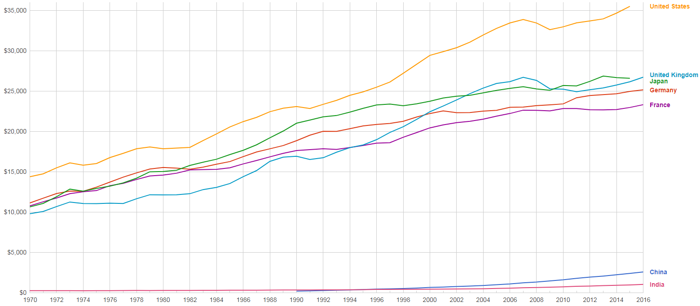
Household Consumption Expenditures Per Capita

Slide 10
World Economic Growth ? Don’t Hold Your Breath

Slide 11
#3 JAPAN $4.9 T
 | Q4 16 | Q1 17 | Q2 17 | Q3 17 | Q4 17 | Q1 18 | Q2 18 | Q3 18 | Q4 18 | Q1 19
GDP YoY | 1.7 | 1.5 | 1.4 | 1.6 | 1.5 | 1.5 | 1.1 | 1.0 | 1.0 | 1.0
UNEMPLOYMENT | 3.1 | 2.9 | 2.9 | 2.8 | 2.8 | 2.7 | 2.7 | 2.6 | 2.6 | 2.6
INFLATION | 0.3 | 0.3 | 0.4 | 0.6 | 0.4 | 0.6 | 0.6 | 0.7 | 0.7 | 0.8
O/N RATE | -0.1 | -0.1 | -0.1 | 0.0 | 0.0 | 0.0 | 0.0 | 0.0 | 0.0 | 0.0
2 YR NOTE | -0.18 | -0.19 | -012 | -0.12 | -0.11 | -0.09 | -0.09 | -0.08 | -0.06 | 0.00
10 YR NOTE | .05 | .07 | .09 | .07 | .05 | .07 | .07 | .11 | .09 | .10
Source : Bloomberg

Slide 12
#2 CHINA $11.2 T
 | Q4 16 | Q1 17 | Q2 17 | Q3 17 | Q4 17 | Q1 18 | Q2 18 | Q3 18 | Q4 18 | Q1 19
GDP YoY | 6.8 | 6.9 | 6.9 | 6.7 | 6.6 | 6.5 | 6.4 | 6.3 | 6.3 | 6.3
UNEMPLOYMENT | 3.1 | 2.9 | 2.9 | 2.8 | 2.8 | 2.7 | 2.7 | 2.6 | 2.6 | 2.6
INFLATION | 1.8 | 2.5 | 1.9 | 1.7 | 1.9 | 2.1 | 2.2 | 2.1 | 2.2 | 2.1
2 YR NOTE | 2.40 | 2.75 | 3.35 | 3.01 | 2.93 | 2.91 | 2.85 | 2.66 | 2.63 | 2.58
10 YR NOTE | 3.06 | 3.29 | 3.57 | 3.62 | 3.61 | 3.58 | 3.54 | 3.54 | 3.50 | 3.50
Source : Bloomberg

Slide 13
#1 US $18.57 T
 | Q4 16 | Q1 17 | Q2 17 | Q3 17 | Q4 17 | Q1 18 | Q2 18 | Q3 18 | Q4 18 | Q1 19
GDP YoY | 1.8 | 2.0 | 2.2 | 2.2 | 2.3 | 2.5 | 2.4 | 2.3 | 2.2 | 2.1
UNEMPLOYMENT | 4.7 | 4.7 | 4.4 | 4.3 | 4.3 | 4.2 | 4.2 | 4.2 | 4.1 | 4.1
INFLATION | 1.8 | 2.5 | 1.9 | 1.8 | 1.7 | 1.6 | 2.0 | 2.1 | 2.1 | 2.1
O/N RATE | .75 | 1.00 | 1.25 | 1.25 | 1.50 | 1.60 | 1.80 | 1.95 | 2.05 | 2.15
2 YR NOTE | 1.19 | 1.26 | 1.38 | 1.49 | 1.64 | 1.76 | 1.91 | 2.06 | 2.23 | 2.41
10 YR NOTE | 2.45 | 2.39 | 2.30 | 2.33 | 2.42 | 2.51 | 2.61 | 2.74 | 2.90 | 3.05
Source : Bloomberg

Slide 14
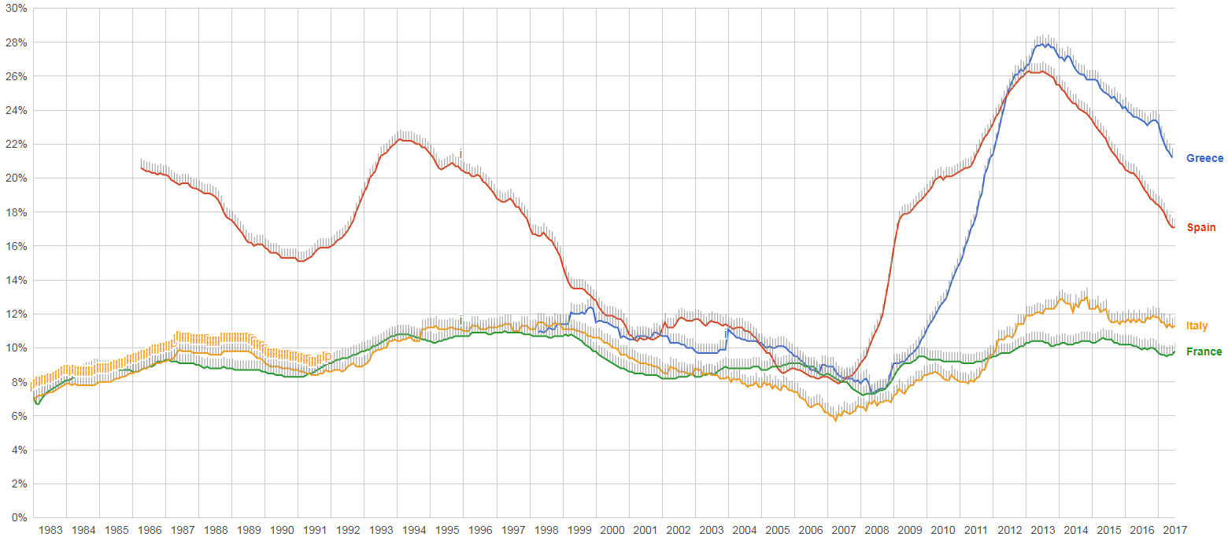
European Unemployment

Slide 15
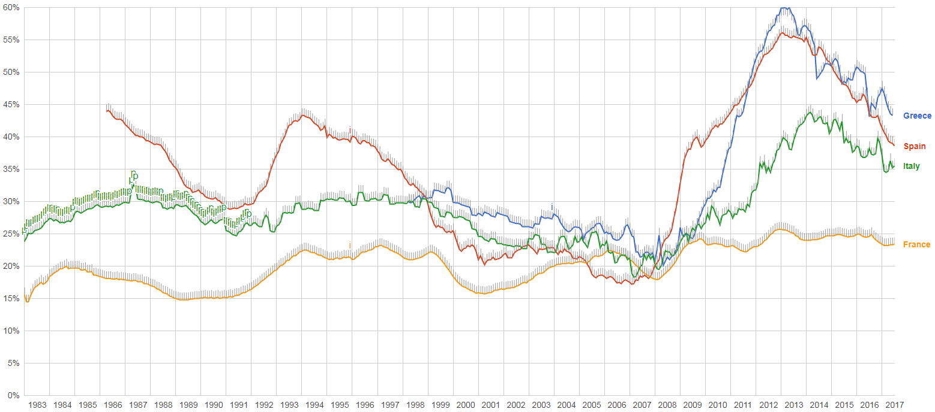
European Unemployment (Under 25)

Slide 16
National Economy

Slide 17
Assumptions
Short Term Interest Rate - are driven by the FOMC (Federal Open Market Committee)
Dual Mandate to maintain a balance between Employment and Inflation
If Unemployment is high they want to be “accommodative/ “EASE” thru Monetary Policy
If Inflation feared to be Rising above a 2% change Year over Year target, they want to be “less accommodative” / “TIGHTEN” thru Monetary Policy
Long Term Interest Rates - are driven by “Long Term” investors worrying about Inflation
Most Economic Indicators (Retail Sales, Housing Starts, etc.) are announced monthly

Slide 18
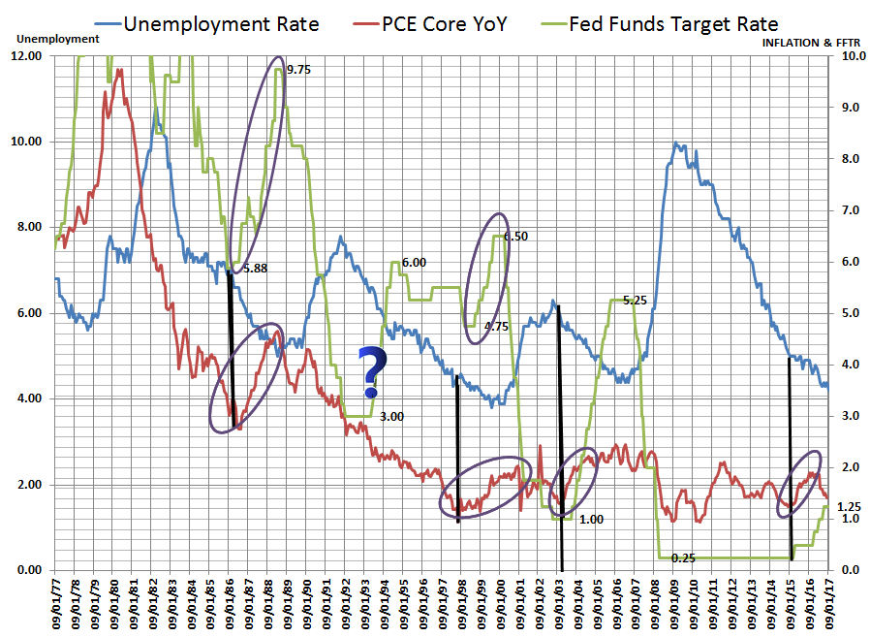
FOMC Mandate
5.30 in May 2015

Slide 19
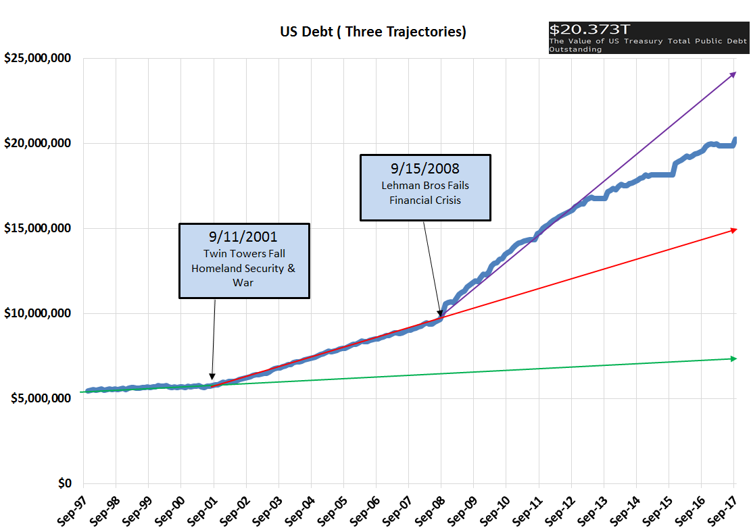

Slide 20
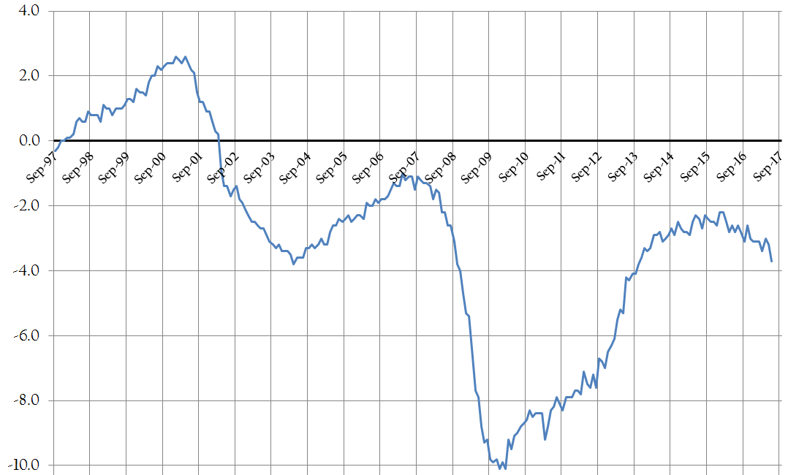
Budget Deficit or Surplus as % of GDP

Slide 21
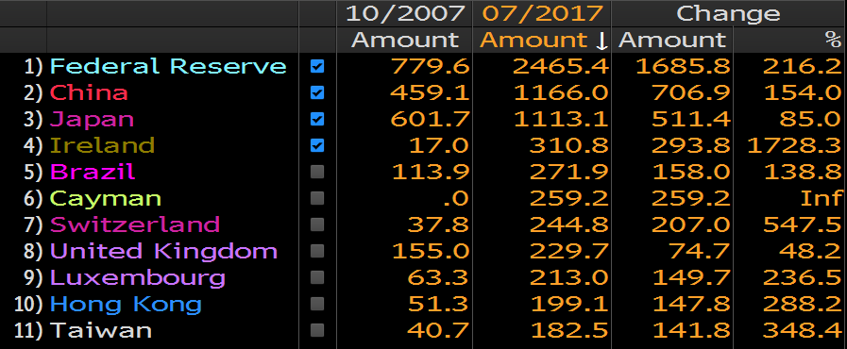
US DEBT HOLDERS

Slide 22
FOMC Dot Plot

Slide 23
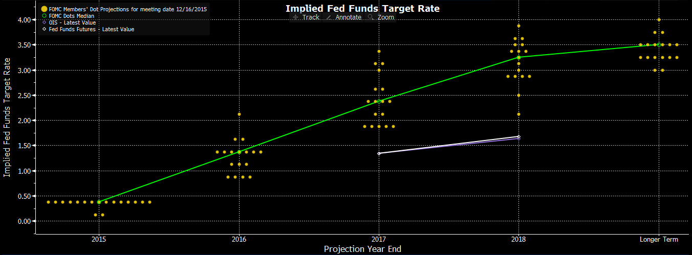
As of December 2015

Slide 24
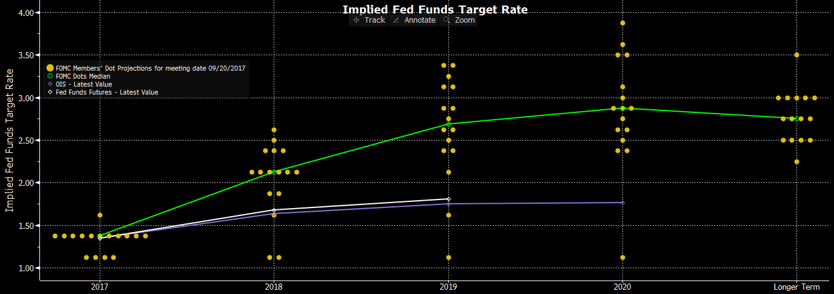
As of September 20th

Slide 25
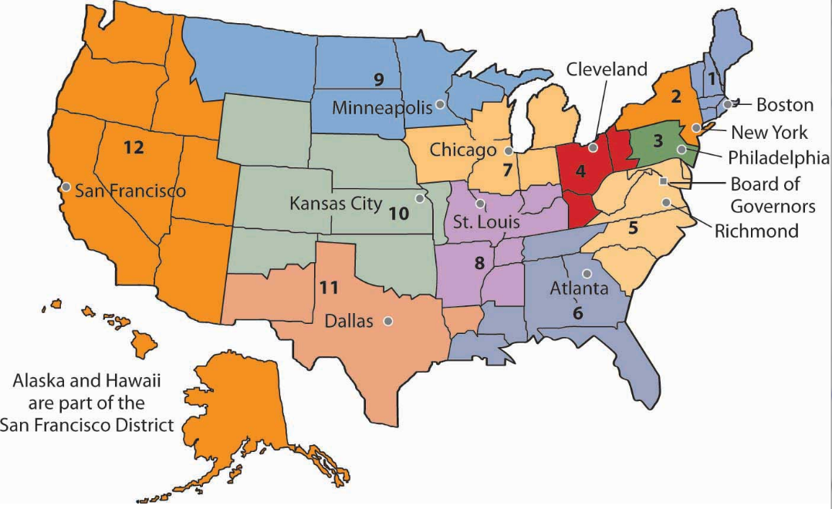
Economic Indicators
Come in different categories and can be looked at many different ways.
One of the more popular is to consider the Federal Reserve’s twelve (12) different districts reports on various components of their local economies.
Often they discuss:
Real Estate & Construction
Manufacturing & Trade Balance
Banking & Finance
Retail & Tourism
Employment & Wages
Agriculture & Natural Resources

Slide 26
Employment and Wages

Slide 27
Employment
Labor demand continued to outweigh supply in fields such as information technology, construction, and healthcare.
Some employers who rely on immigrant labor—either directly or indirectly—continued to express concerns that efforts to tighten immigration were having a tangible drag on the supply of labor.
Firms continued to implement various methods to attract and retain top talent, often in lieu of wage increases. Contacts shared that in addition to offering flexible work hours and locations, more vacation time, and training and education opportunities, they were increasingly focused on social responsibility initiatives and support systems to encourage work-life harmony.

Slide 28
Wages
Businesses continued to report increases in starting wages to attract new hires for high-skill positions, but most contacts indicated that these increases remained in the two to three percent range.
Non-labor input costs were stable and businesses reported that pricing power remained constrained.
According to the Atlanta Fed’s Business Inflation Expectations survey, respondents indicated that year-over-year unit costs were up 1.7 percent in August and they expect unit costs to rise 1.9 percent over the next twelve months.

Slide 29
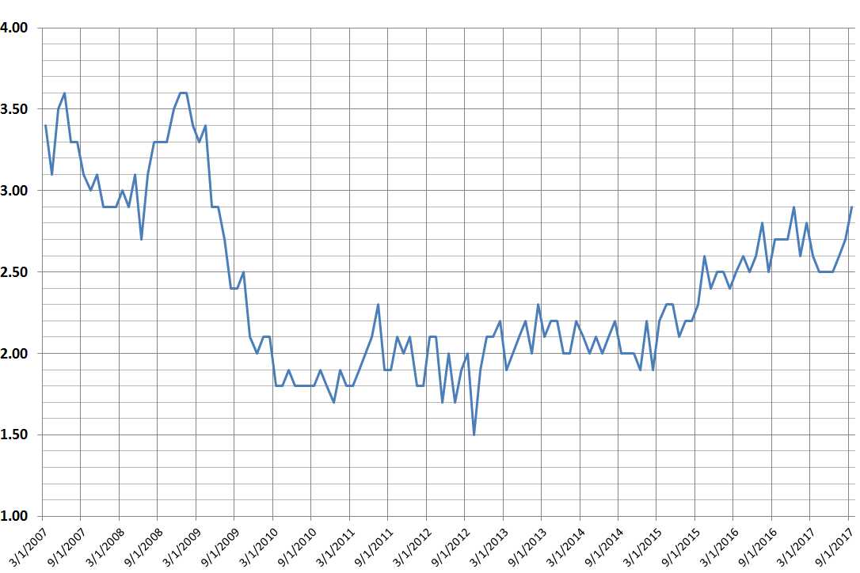
US Average Hourly Earnings YoY %

Slide 30
Manufacturing & Trade

Slide 31
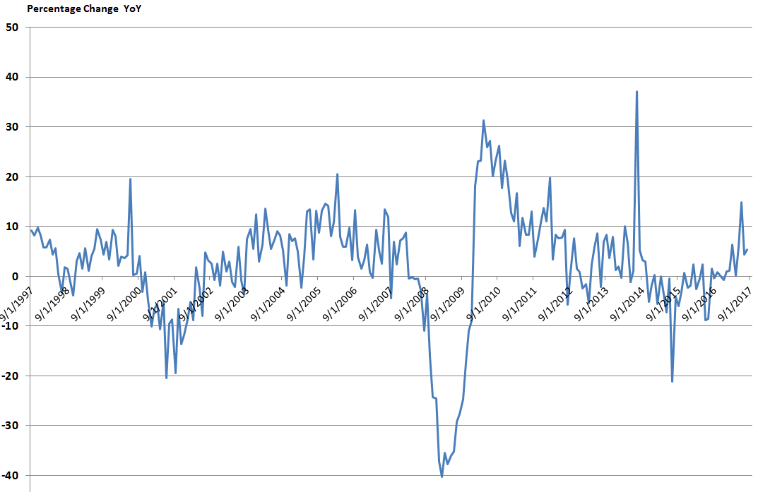
Durable Goods

Slide 32
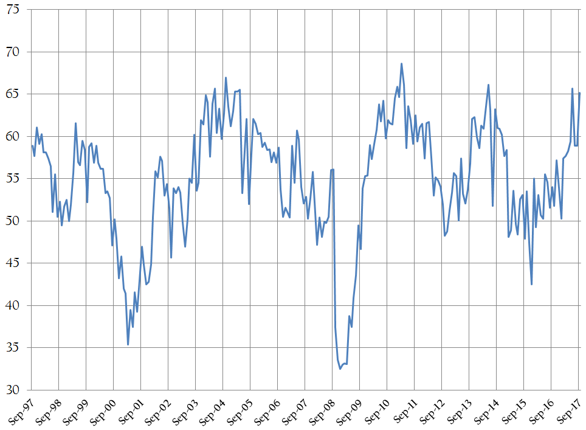
Chicago Purchasing Managers Index

Slide 33
Banking & Finance

Slide 34
Small to medium sized banks in the District reported that loan demand was steady overall but mixed by category—weaker demand for consumer loans and residential mortgages, no change in demand for commercial mortgages, and higher demand for C&I loans.
Bankers also noted a moderate decrease in refinancing activity. Some tightening in credit standards was reported for commercial mortgages, but no change was indicated for other loan categories. Contacts reported lower spreads of loan rates over cost of funds for residential mortgages and C&I loans. Finally, banks reported steady delinquency rates across all loan categories.

Slide 35
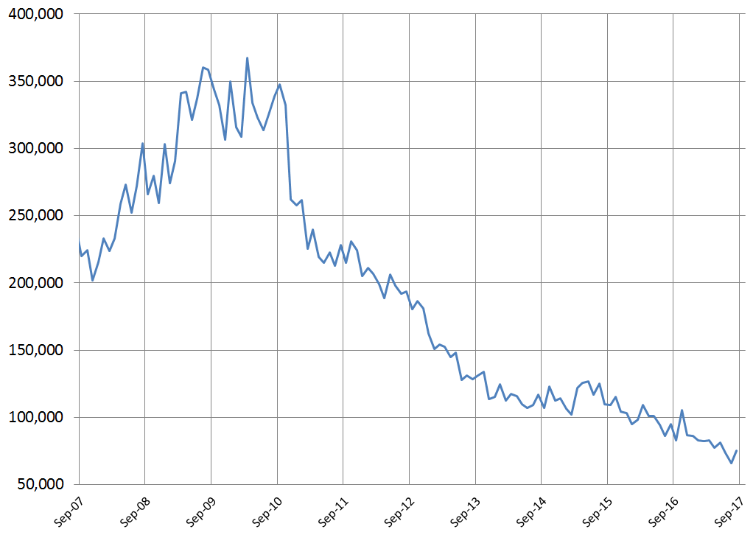
US Home Foreclosure Filings

Slide 36
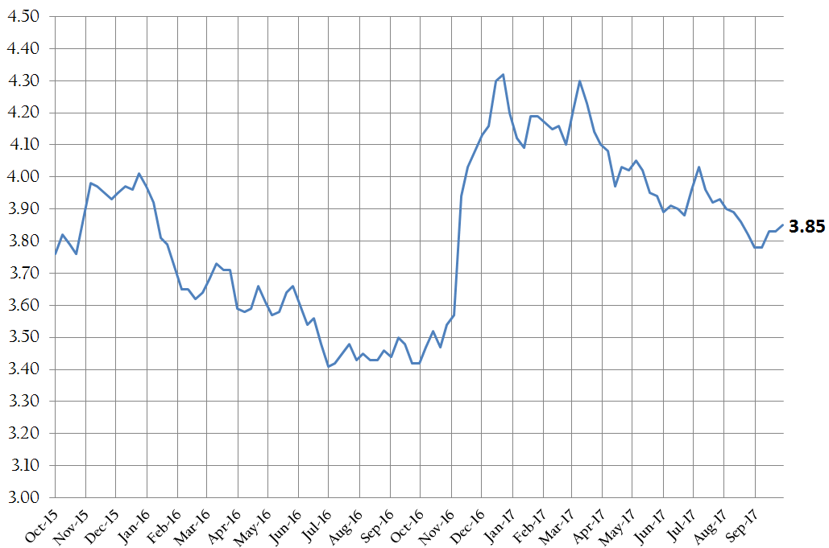
30 YR FHLMC Commitment Rate

Slide 37
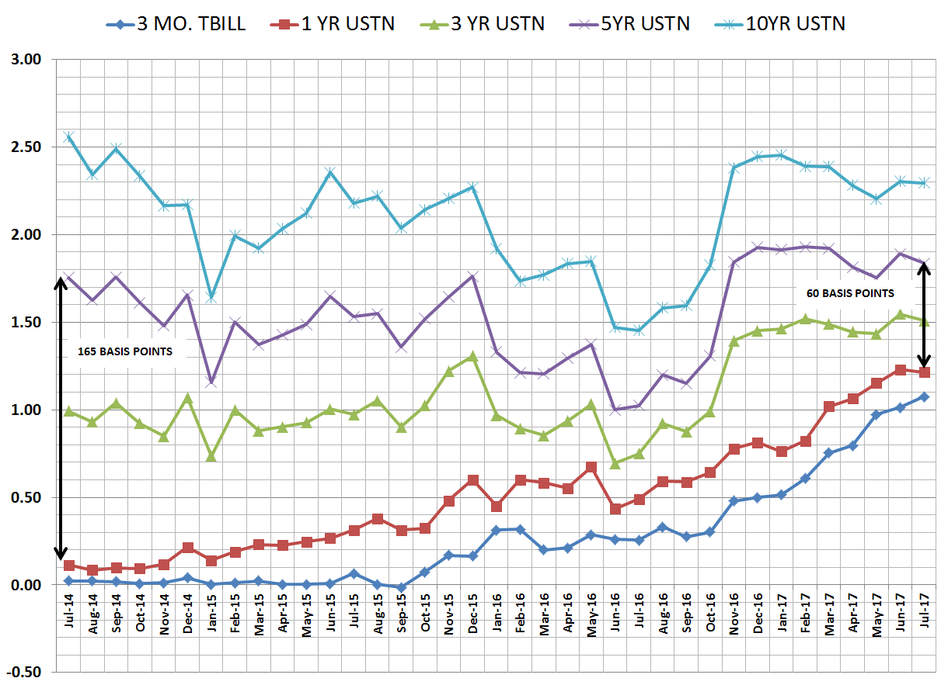
FLATTENING YIELD CURVE

Slide 38
Real Estate & Construction

Slide 39
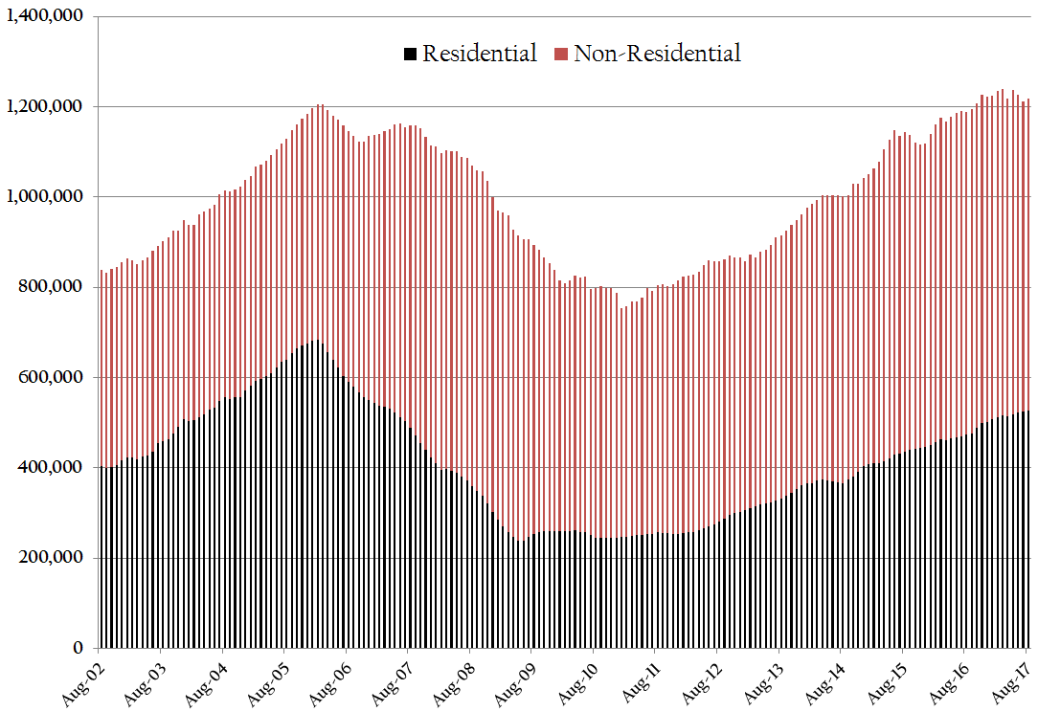
Construction Spending

Slide 40
Real Estate & Construction
Low inventory prevails. On a year-over-year basis, all reporting areas experienced a sharp decrease in inventory for both single-family homes and condos.

Slide 41
Local Economy

Slide 42
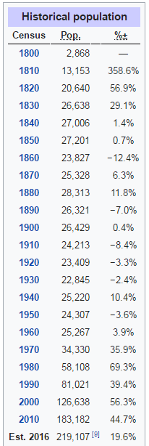
Williamson County
The median home value in Williamson County is $434,300. Williamson County home values have gone up 7.4% over the past year and Zillow predicts they will rise 2.6% within the next year. The median list price per square foot in Williamson County is $178, which is higher than the Nashville Metro average of $150. The median price of homes currently listed in Williamson County is $539,900. The median rent price in Williamson County is $2,000, which is higher than the Nashville Metro median of $1,600.

Slide 43
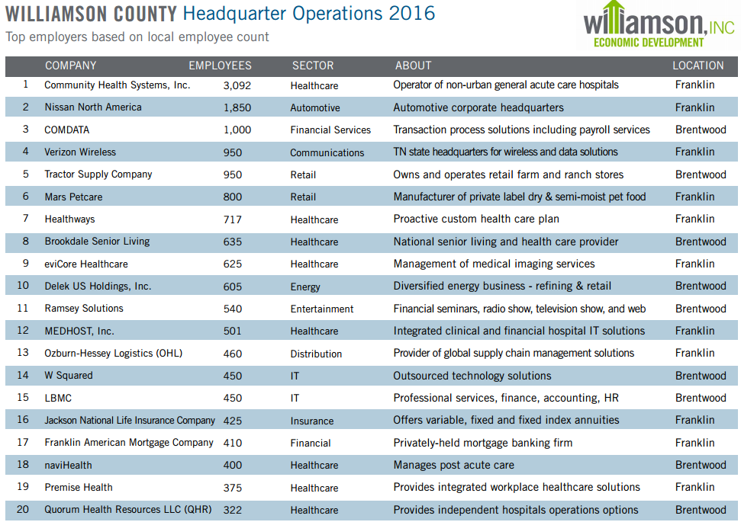

Slide 44
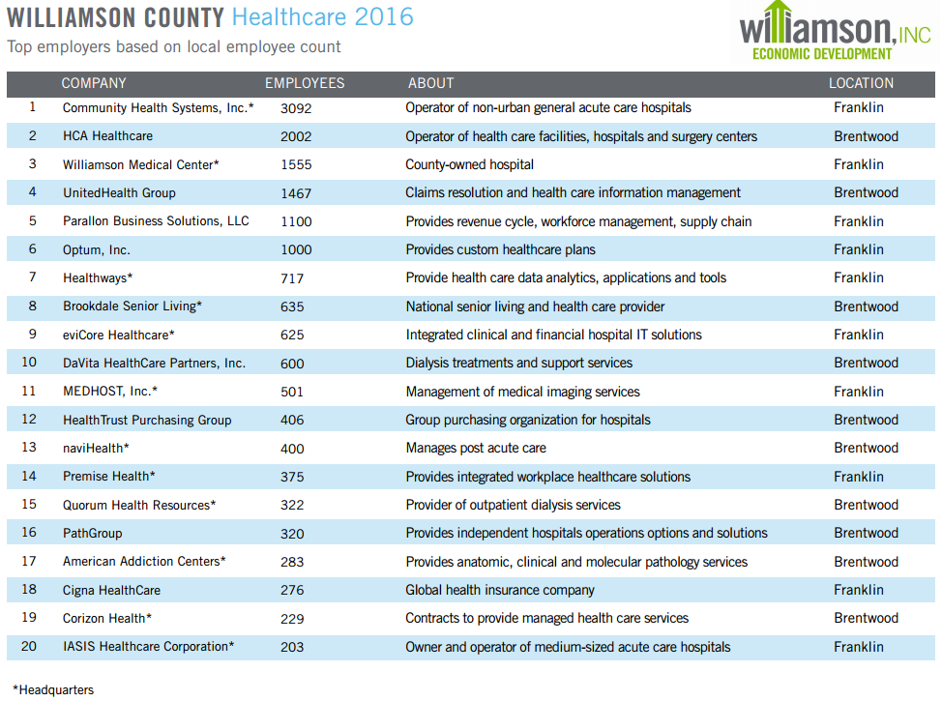

Slide 45
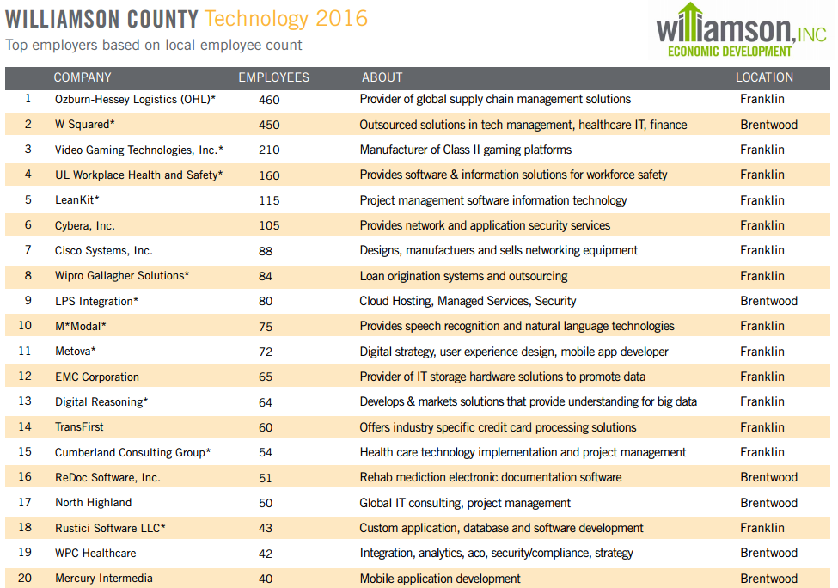

Slide 46
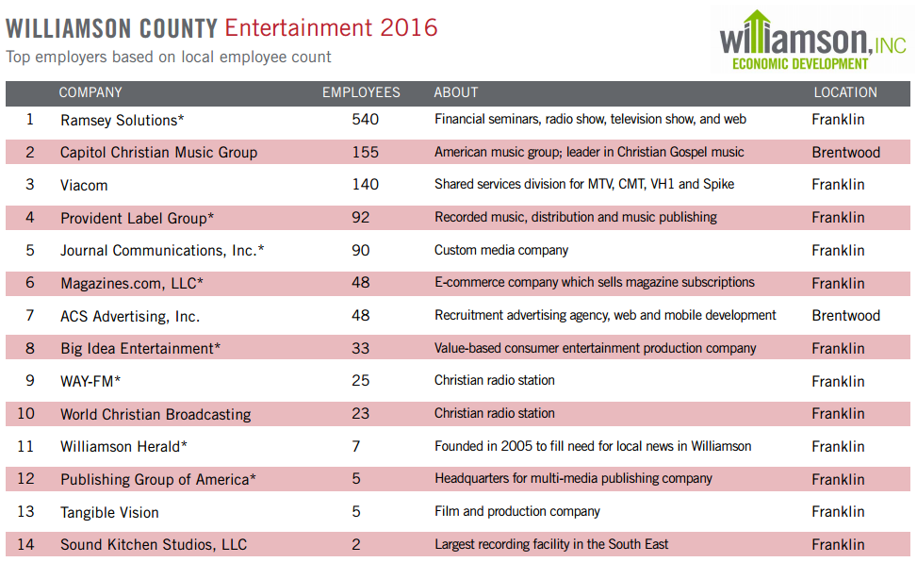

Slide 47
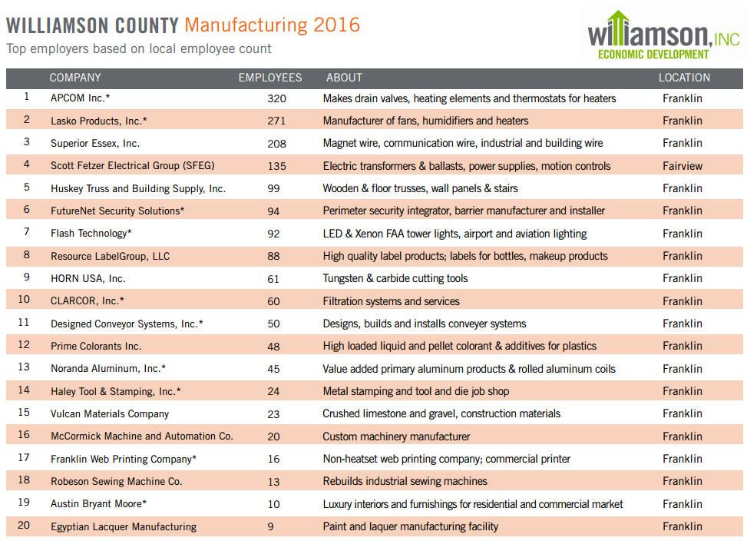

Slide 48
Rutherford County
The median home value in Rutherford County is $200,900. Rutherford County home values have gone up 12.7% over the past year and Zillow predicts they will rise 4.3% within the next year. The median list price per square foot in Rutherford County is $129, which is lower than the Nashville Metro average of $150. The median price of homes currently listed in Rutherford County is $260,900. The median rent price in Rutherford County is $1,430, which is lower than the Nashville Metro median of $1,600.

Slide 49
Davidson County
The median home value in Davidson County is $236,500. Davidson County home values have gone up 12.7% over the past year and Zillow predicts they will rise 4.2% within the next year. The median list price per square foot in Davidson County is $192, which is higher than the Nashville Metro average of $150. The median price of homes currently listed in Davidson County is $339,900. The median rent price in Davidson County is $1,650, which is higher than the Nashville Metro median of $1,600.

Slide 50
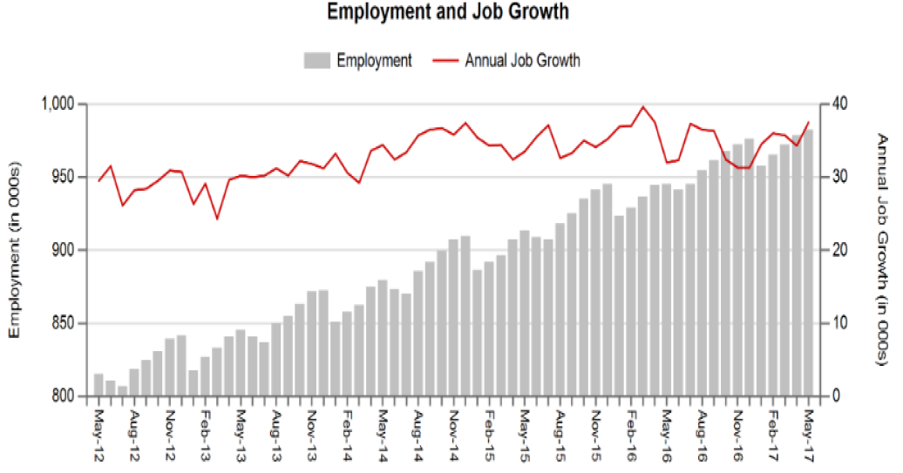

Slide 51
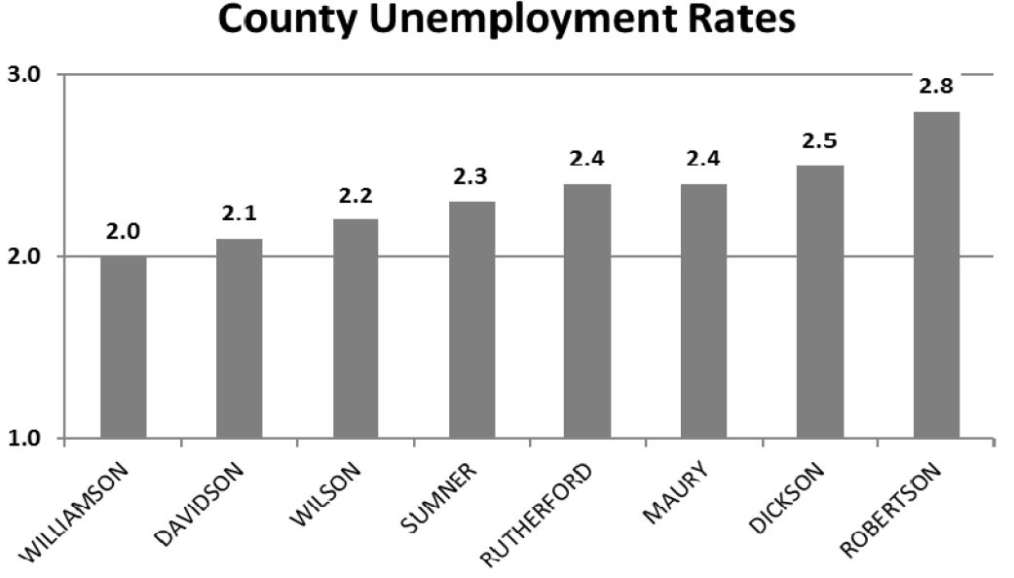

Slide 52
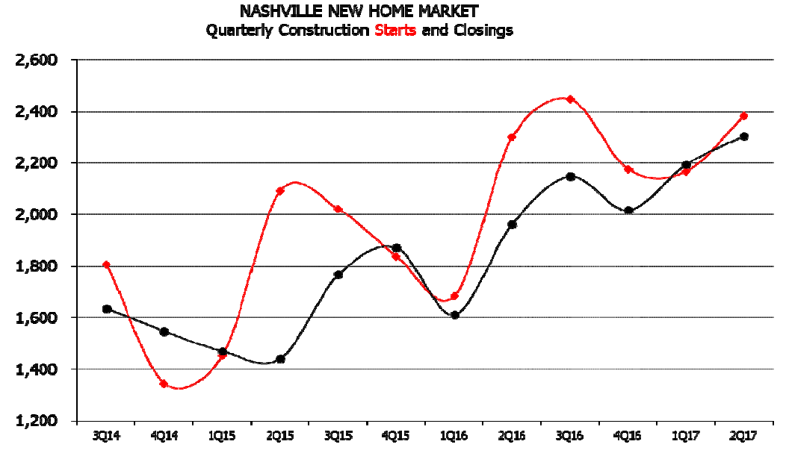

Slide 53
Why is Nashville The “IT” City?

Slide 54
Four S’s
Scenery- Lush Green Open Spaces
Southern Charm-
You leave feeling good
If you accidently cut someone off changing lanes, they smile and wave rather than leaning on their horn and gesturing.
Serious About Education
Serious About Worship

Slide 55
Locating in Williamson County means you have direct access many opportunities for higher education and an extremely well educated workforce.
Within the Nashville region there are 24 four-year universities and colleges with over 92,000 students enrolled
8 community colleges with over 32,000 students enrolled
14+career colleges with nearly 10,000 students enrolled.
In Williamson County 52% or residents have a Bachelor’s degree or higher, 17% have earned a Graduate, Professional or Doctorate.

Slide 56
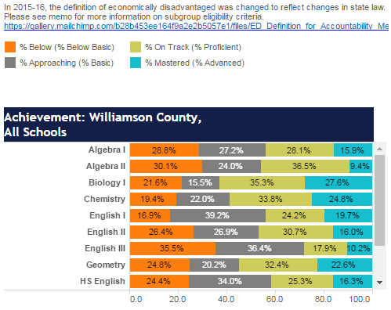
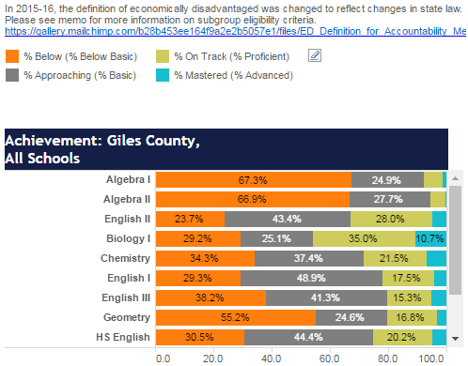
Williamson County Average Exceeds 25 ACT Score

Slide 57
Tennessee can now back its moniker as the "buckle of the Bible Belt" with solid numbers. - Tennessean
The Belt Is Still Buckled
Christianity Today
America's 100 Most Bible-Minded Cities of 2016
#1 Chattanooga
#5 Tri Cities
#8 Knoxville
# 16 Nashville
Tennessee is home to more megachurches per capita (67) than any other state, according to the Hartford Institute for Religion Research. The state has more than one megachurch for every 100,000 people.

Slide 58
What Does Knowing Economics Mean to Me? We Are Blessed!
Great Town
Great County
Great State
Greatest Country In the World
Notes:
One thing I like to make sure I remember everyday as I drive through some of the prettiest land in all of Williamson County on the way to work, and it gets re-affirmed to me every time I look at Global Economic Statistics.

