Slide 1
Blockchain and Cryptocurrency
Overview
John Wagster
Co-Chair, Blockchain and Cryptocurrency Practice

Slide 2
AGENDA
High Level Overview
Blockchain Technology
Cryptocurrency Distributions (ICOs, IEOs, Dex)
Smart Contracts
Stablecoins
Decentralized Finance
Regulatory Landscape
Government-backed Digital Currency

Slide 3
Terminology
Blockchain ≠ Bitcoin
Tokens ꞊ Coins

Slide 4
What’s the Big Deal About Blockchain?
Blockchain technology today is like the internet in 1993
Distributed Ledger technology allows secure, verifiable communication between trustless parties without a middleman
Consider the evolution in computing:
Mainframe - LAN/WAN – PC – hosted servers – cloud-based server arrays – distributed computing
Distributed computing has no single controlling authority-it is controlled by the consensus of all users.
Users can connect directly to the blockchain without third party assistance

Slide 5
Cryptocurrency Timeline
2008 Creation of Bitcoin
Early to mid 2017
Mayhem fueled by rise in Bitcoin prices and generation of new crypto wealth
Mid to late 2017
Big Ideas are rewarded
Astronomical returns attract real investors
Real investors restore sanity to the market
Q1 2018
Regulatory scrutiny sobers market
Fast, easy money no longer available
Good ideas still get funded
2020 – Decentralized Finance
2021 – non fungible tokens - NFTs

Slide 6
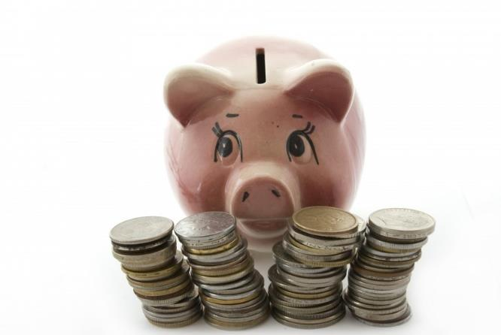
Initial Coin Offerings – Predecessor to Defi
What’s the Big Deal with ICOs?
Why do we need cryptocurrencies?
Birth of Bitcoin
An easier way to raise $
Improvements with Ether, Tron, Solana, Cardono and other tokens
Appx 13,000 Coins in existence today

Slide 7
IEOs – Initial Exchange Offerings
Rapidly growing, one-stop shop approach to launching a cryptocurrency.
ICOs and STOs typically require multiple rounds of funding (pre-sale, SAFT, crowdsale) with each step requiring time and money
IEOs launch with the backing of an existing exchange
Exchange vetts the project
Regulatory hurdles are already met by exchange
Exchange promotes the token
Trading market (liquidity) exists on day one.

Slide 8
IEOs, cont.
Most crypto exchanges list outside of US to avoid US regulatory scrutiny
Delaware Board of Trade Holdings (DBOT) is one of a few US ATS fully licensed by the SEC
Last year a 30% stake was purchased by Chinese billionaire Bruno Wu.
Binance, Bitfinex, Bittrex, Gemini, Coinbase
Exchanges act as custodians – for a fee
US exchanges are hampered by their inability to offer derivative trading so high volume traders remain overseas.
Some purists avoid Centralized Exchanges

Slide 9
Decentralized Exchanges
Not run by any centralized organization or group
There is no Order Book; simply maker/taker functionality
Founders establish a set of trading rules and interactions
Individuals establish Nodes (computer servers) to process transactions
All trades are executed through and recorded on the Blockchain
All interactions are controlled by smart contracts

Slide 10
What is a Smart Contract?
Most Distributed Apps operate through mechanisms known as smart contracts
Smart contracts are self-executing software programs that take effect as the participating parties agree in advance.
Vending Machine Example:
Put $1 in, a soda comes out
If you don’t put $1 in, no soda comes out
If you don’t put $1 in, and a soda comes out, that’s bad
A smart contract controls digital assets using the pre-determined conditions of an agreement.

Slide 11
Smart Contract Example
A farmer wants insurance to protect against a drought. If the temperature is more than 100 degrees for 50 days in a year, he receives $50,000.
Today, the farmer would need to collect information about the weather and submit it to the insurance company to make a claim.
Must submit properly and on time
Must wait to learn if he will be reimbursed
With a smart contract, the conditions of the policy (# of days and temperature) can be automatically derived from acknowledged public sources and the payment would be automatically made to the farmer if the correct criteria are met.

Slide 12
Smart Contracts, cont.
Smart contracts allow for programmable money
Geofencing
Restrictions on transfer, lockups, hold periods
Restrictions on use

Slide 13
What Are Stablecoins
value pegged to a real-world asset, typically fiat currency
Very important to the cryptocurrency ecosystem because of low volatility
Can be transferred quickly and cheaply
Usually redeemable for cash
Also threatens governmental control
Diem, USDT, USDC

Slide 14
What’s the big deal about Decentralized Finance? From Defi Pulse

Slide 15
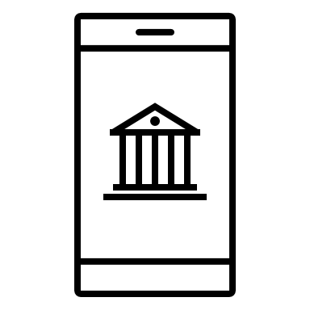
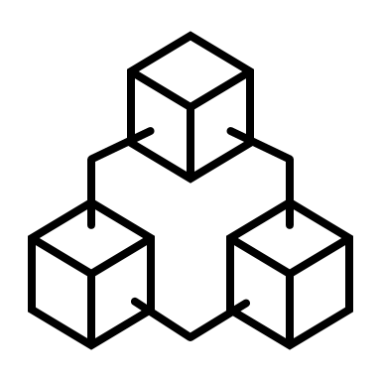
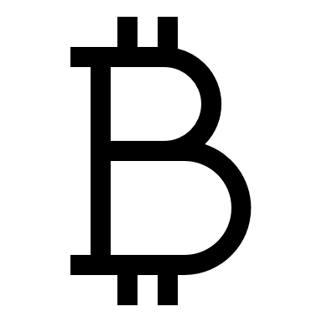
What is Decentralized Finance or “Defi”?
Defi is a complex array of platforms on the Ethereum blockchain through which borrowers, lenders and investors can undertake bank-like transactions without banks. Importantly, Defi runs on individual accounts hosted on digital wallets that are accessible to anyone in the world with an internet connection. Defi allows users to store and transfer value and create and access any imaginable financial product on the same terms as anyone else. No banks. No brokers. No politics.

Slide 16
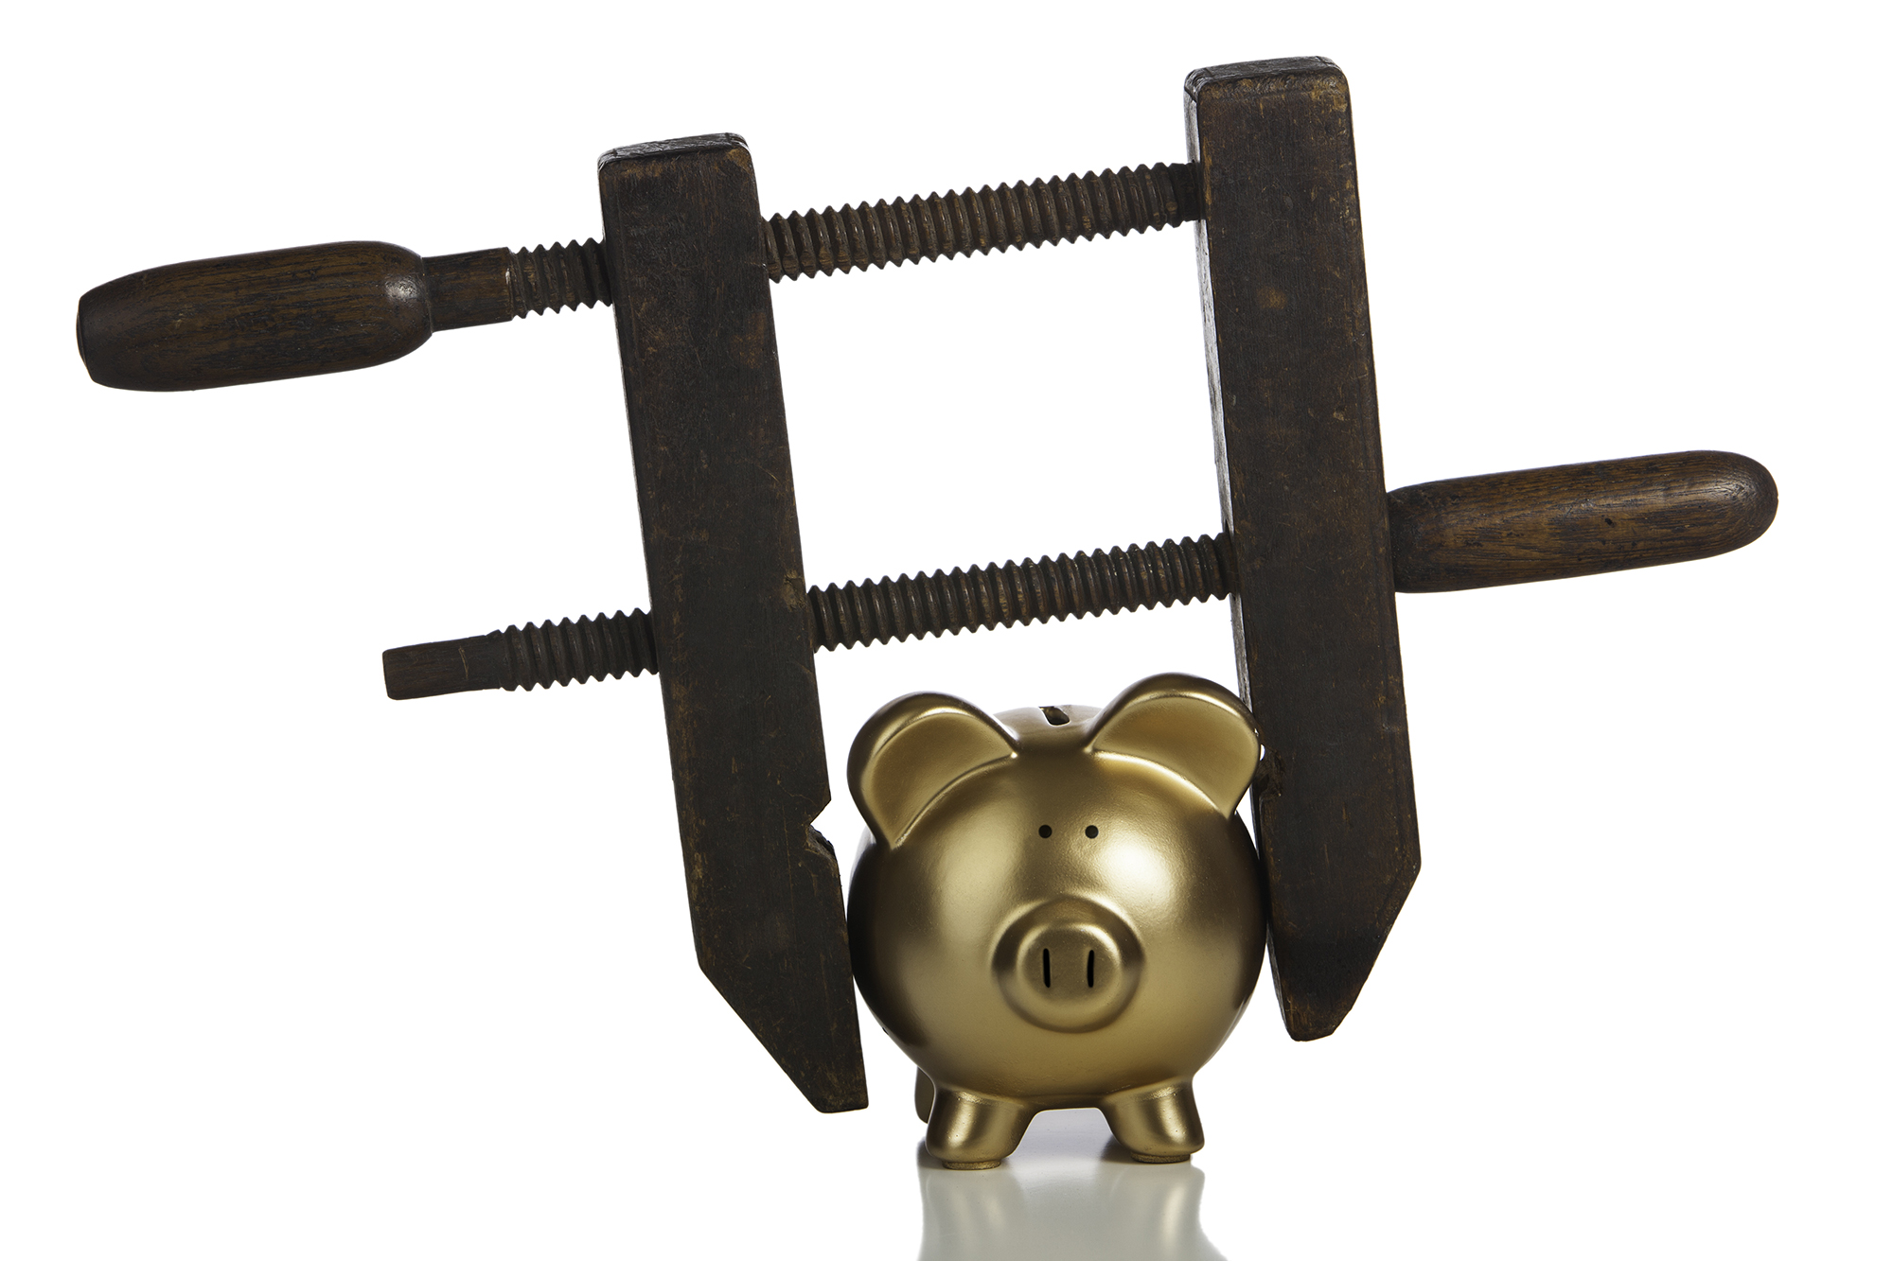
What is Defi, continued
The centralized financial system is managed by governments through monetary policy that benefits a particular constituency.
Since all first world economies are essentially global, the actions of competing political systems can cause tumultuous effects when they encounter each other in the global markets
E.g. the recession of 2008
Decentralized Finance benefits all users equally without political or social intervention
Instant access to debt and equity markets without a bank or a broker
Ability to earn interest MUCH higher than centralized investment accounts

Slide 17
Difference between Defi and ICOs
Each ICO creates a new cryptocurrency that has its own purpose.
Defi are Networks (aka protocols or applications) that allow holders of some cryptocurrencies to lend or borrow the value of their cryptocurrency to other users of the Network by “staking” the value in the Defi protocol.
Stakers earn interest (sometimes called by other names) for making the value of their crypto available to other protocol users.
Borrowers pay interest to borrow the value of cryptocurrency that has been staked by stakers
The rules of staking and lending vary from protocol to protocol, but most are ultimately governed by the users of the protocol
Defi protocols incent users with rewards

Slide 18
Defi Example – Yield farming
Yield farming defi protocols are those that incent users to their platform by giving users governance tokens just for using the platform
Not only do the users receive interest for staking to the platform’s liquidity pool, they receive a native governance token that entitles them to vote on proposed changes AND sometimes receive a portion of the platform’s profits.
Such protocols are known as “yield farming” because the value or “yield” of the native tokens earned by “planting” crypto into a protocol can exceed the value of the interest paid by the protocol.
Some examples of behavior that might be rewarded by a yield farming protocol are:
Using the platform
Lending on the platform
Staking a particular token to the platform
Voting on governance proposals to maintain the platform

Slide 19
Regulatory Landscape
Securities and Exchange Commission
Commodities Futures Trading Commission
FinCen-Financial Crimes Enforcement Network
Office of the Comptroller of the Currency
U.S. Department of the Treasury
The Federal Reserve

Slide 20
Questions?
Frost Brown Todd LLC
John Wagster Chair, Blockchain and Cryptocurrency Practice 615.251.5586 | jwagster@fbtlaw.com

