Slide 1
Platform effect:
The future for the eco-system of finance, banks and technology
Trevor Brown VP Kyriba

Slide 2

Liquidity hippie
Openness
Traditional establishment
Community
Sharing
Peace
Prosperity

Slide 3

User-vendor relationships
Direct
Channel
Partner industries
Treasury software
AP/AR
Payroll
Core systems
ERP
Supply chain finance
Money market funds
FX risk management
Payments
Blockchain/Distributed ledger
Partner
End user
End users

Slide 4
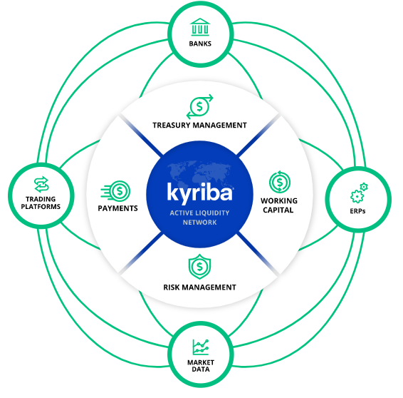
Eco-system
Network effect brings collaboration at an exponential scale
“The tide that floats all boats”
Platform

Slide 5
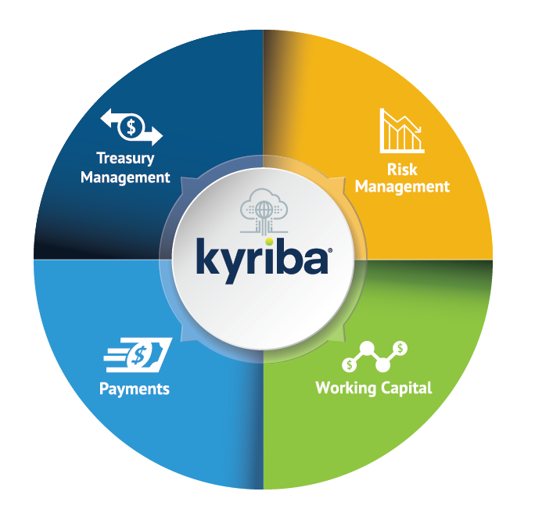
Core treasury enhancement
See
Protect
Connectivity
Move
Enhance

Slide 6
Banks + Fintechs
What are the banks doing?
How do they fit in with fintechs?
What does the future look like?

Slide 7
Enemies -> Frenemies -> Partners -> Family
Fintech firms hit $3.5 trillion in global transaction value in 2017 and that's expected to reach about $8 trillion by 2022, growing at a compound annual rate of 18%, according to Statista's "2017 FinTech Report.”
Venture capital fintech deals and financing reached a record $16.6 billion last year, more than four times the 2013 level, as outlined in CB Insights' "Fintech Trends to Watch in 2018.“
Banks
Fintechs
Reputation
Customer dist
Balance sheet
Resource
Infrastructure
Security
Nimble
High tech
High touch
Flexible pricing
Transparent pricing.

Slide 8

Cross-pollination is under way
77%
BMO Harris bank expanded its in-house accelerator program to have a national reach
Wells Fargo integrated Transfermate’s AR solution
Moneycorp acquired Brazil’s Novo Mundo bank
Barclay’s partners with FiREapps to help clients manage FX risk management
BBVA launched its Open Innovation Accelerator to “foster even greater success among the fintech startup ecosystem it engages with.”
of Banks are looking to increase tech partnerships
45%
Of banks already have API frameworks for partnering
65%
of global banking profits will come from data driven products.

Slide 9



Endless symbiosis
Relationship types
In order to cooperate successfully, banks have to integrate the advantages FinTech offers into their processes, giving way to innovation and a change in approach. Platforms tie everything back into the core system.
OEM/whitelabel
Co-brand co-sell
Referral (both ways)
Value add reseller (mostly banks reselling fintechs)
Product
Middleware
Direct customer vendor
Supply Chain Finance
Money Market Funds
Payments
Whitelabeling of off the shelf factoring programs bringing buyers, suppliers and lenders together. Vendor management and onboarding.
Automate the sweeping of overnight funds into investement accounts to enhance cash. Integrated and optimimzed.
Smart routing of different payment profiles to appropriate banks/rails. Optimal pricing and monetization

Slide 10















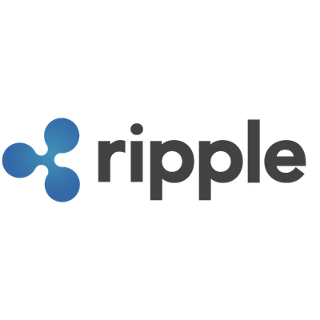
Payments hub as an eco-system
ERP
ACH
Payroll
Wires
Blockchain
AP/AR
Payments hub
SWIFT, FTP, API
Other Systems
INITIATED WITHIN KYRIBA
Cross-Border Payments
Smart routing
Manual Payments
Financial Transactions
PSD2
Virtual card
Real-Time Payments

Slide 11
Transform how you use liquidity as a dynamic vehicle for growth and value creation.

