Slide 1
What’s Next in Payments Automation
Presenter:
Mark Brousseau, Brousseau & Associates

Slide 2
Today’s Speaker
Mark Brousseau
Brousseau & Associates
Mark Brousseau is a noted analyst, speaker, writer and marketer, with more than 27 years of experience in advising leading providers of financial operations solutions and services.

Slide 3
Critical Challenges in Accounts Payable
Risk, fraud & compliance
Control & visibility
Exception handling
Growth management
Vendor data management
International payment requirements
Inefficiency: workflows & process
Supplier demands
Decentralized AP

Slide 4
How Businesses Pay Suppliers
90%
Mark Brousseau, President of Brousseau & Associates
Source: Institute of Finance and Management (IOFM) Future of Accounts Payable Study

Slide 5
Traditional Payment Processes Bog AP Teams Down
integration of acquired entities
expansion in number of physical locations
manual recon-ciliations
payment
risk
failed
payments
more than one ERP system
pressure to reduce operational costs
multiple bank accounts
security exposure
multiple approval workflows
duplicate invoice payments
complex system integration
changing compliance require-ments
global payments
lack of IT resources
tens of thousands of payments
ever-changing supplier information
thousands
of suppliers
frustrated suppliers
antiquated processes

Slide 6
How the Typical AP Practitioner Spends Their Time
Source: Institute of Finance and Management (IOFM) Future of Accounts Payable Study

Slide 7
ACH Will Dwarf Checks within 3 Years
70% of businesses currently have a strategy in place to increase the percentage of payments to suppliers that they make electronically
Source: Institute of Finance and Management (IOFM) Future of Accounts Payable Study

Slide 8
Best-in-Class AP Departments Pay Suppliers Electronically
Source: Ardent Partners 2019 State of ePayables Report

Slide 9
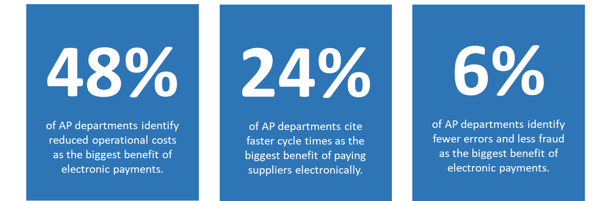
Why Businesses Pay Suppliers Electronically
Source: Institute of Finance and Management (IOFM) Future of Accounts Payable Study

Slide 10
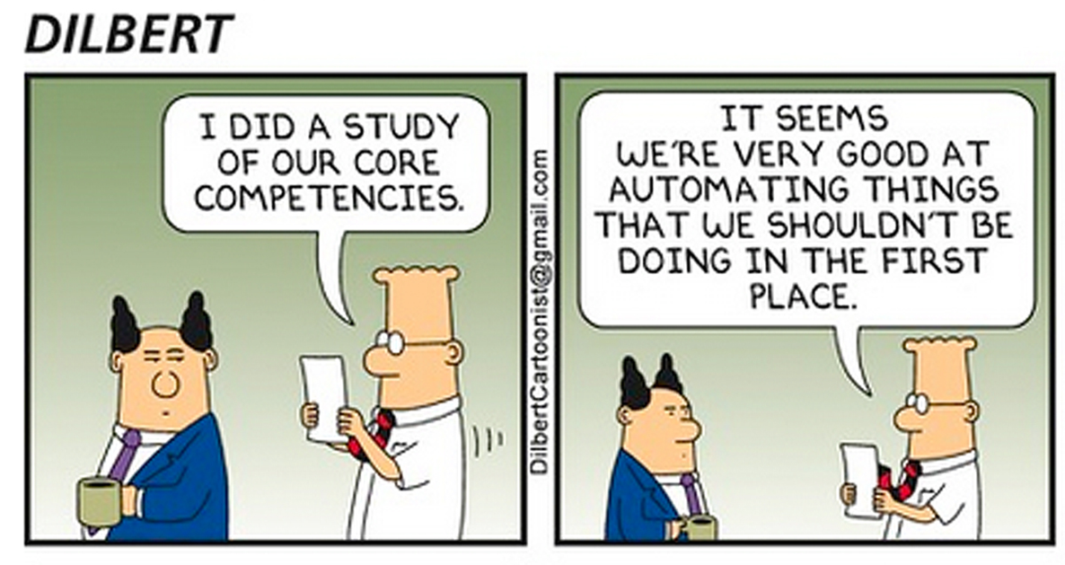
Mark Brousseau, President of Brousseau & Associates

Slide 11
Accounts Payable as a Profit Center
Source: Institute of Finance and Management (IOFM) Future of Accounts Payable Study

Slide 12
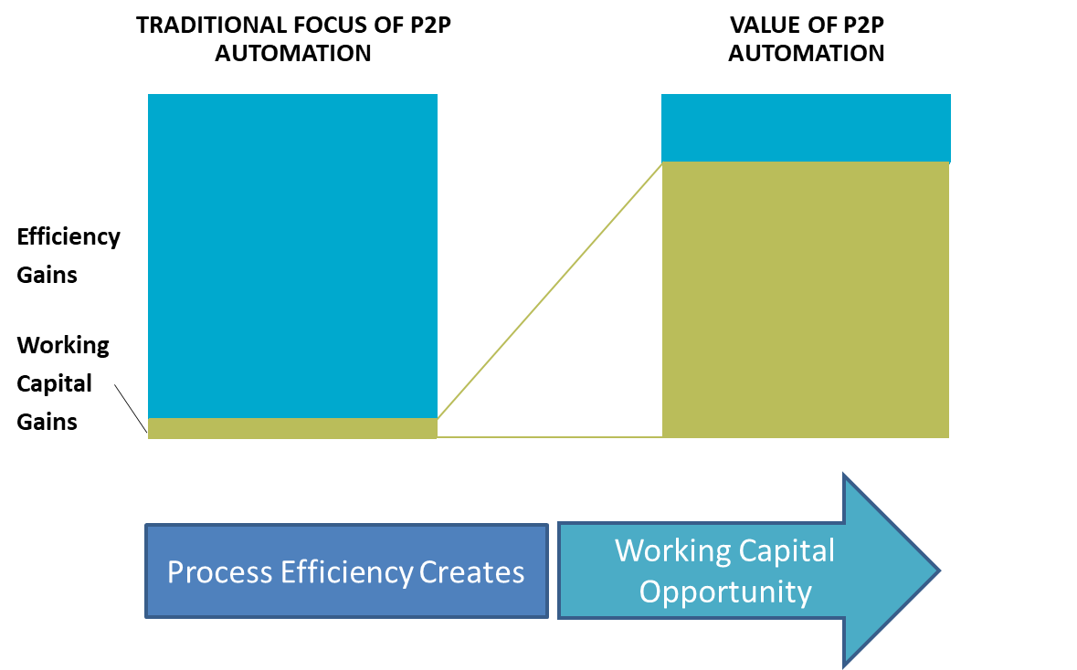
Mark Brousseau, President of Brousseau & Associates

Slide 13
Senior Management is Championing Payments Automation
Mark Brousseau, President of Brousseau & Associates
Source: Institute of Finance and Management (IOFM) Future of Accounts Payable Study

Slide 14
Payments Impact the Metrics Senior Management Cares About Most
Source: Institute of Finance and Management (IOFM) Future of Accounts Payable Study

Slide 15
Payment methods that were targets of attempted and/or actual payments fraud in 2018
Checks
Wire Transfers
ACH Debits
Corporate/Commercial Credit Cards
ACH Credits
Source: Association for Financial Professionals

Slide 16
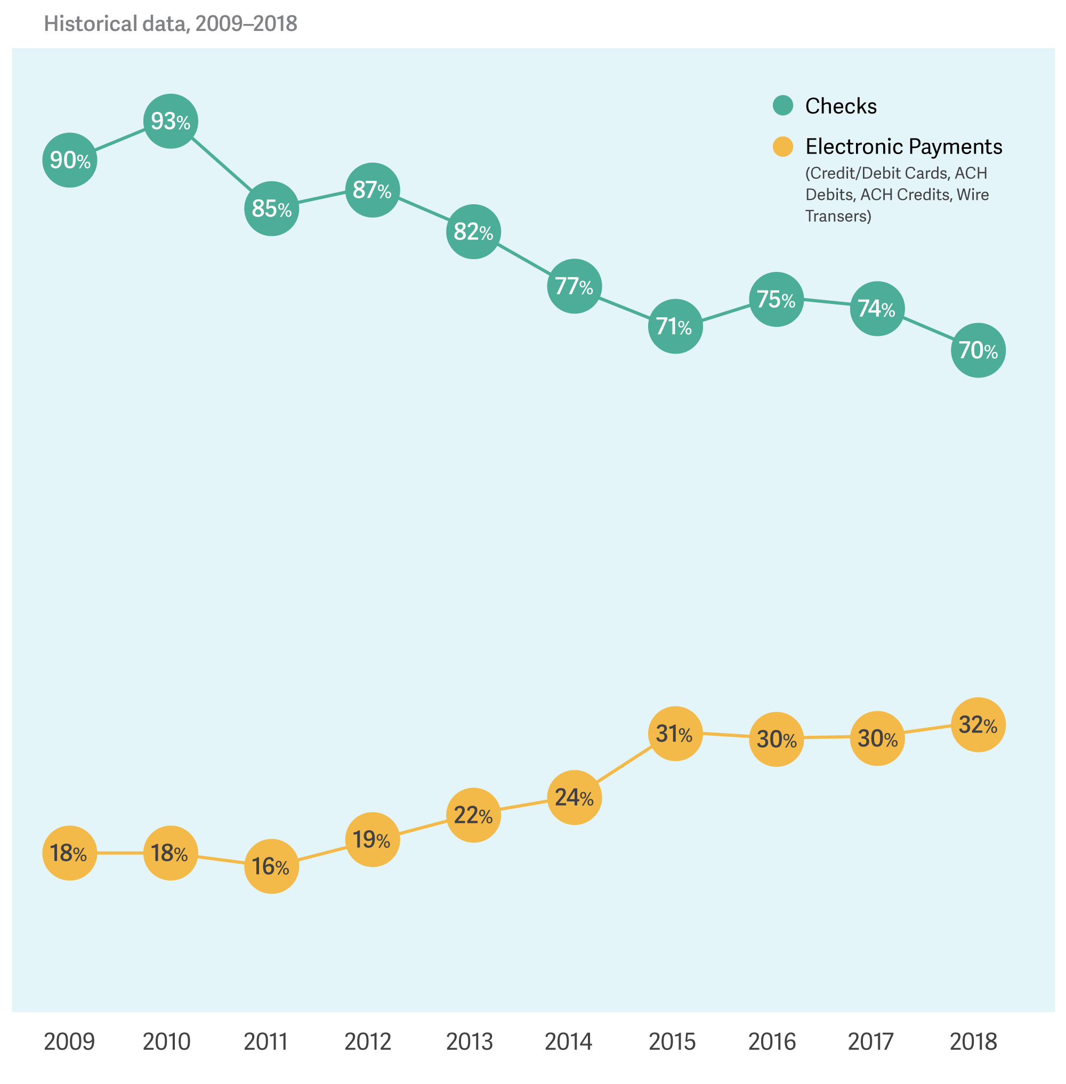
Historical Trend of Fraud for Payment Methods
Checks are the payment method most subject to fraud, but instances being reported are on the decline
Wire fraud continues to be at elevated levels, Business Email Compromise (BEC) a likely cause of attacks
Fraud activity with cards on the decline
ACH debit fraud has increased to record levels and continues its upward trend
A steady increase in ACH credit fraud since 2012
Source: Association for Finance Professionals

Slide 17
Barriers to Electronic Payments
Source: Institute of Finance and Management (IOFM) Future of Accounts Payable Study

Slide 18
Panel Discussion

